Slide 1
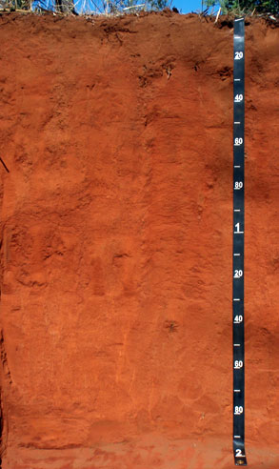
Neural Network Models for Pattern Identification in Soil Data
Zhichuan (Leo) Lu
Jan 2021
Notes:
Good morning!
Last year, I was honoured to have the opportunity to work on the soil data pattern identification with DES.
Today, I’m glad to be here to present my work.
Before I start, I would like to thank my supervisors, Peter, Evan, and Max, for their professional contributions and warm kindness, thank you!

Slide 2





















Notes:
Ok, let’s start my presentation with some lovely faces.
If I say, today, our task is to identify the pictures and classify them to different animals like “Dog” “Cat” “OWE” AND Girrafe” , I believe everyone in our room can do it within 1 or 2 minutes even some animals trying to hide their real identities with masks on. And the next task is: can machines, computers do the same thing? No for before but yes for now, thanks for the huge progress of NN technology for the last 10 years. Actually not just yes, the machines can identify and classify the pictures in a much quicker way with much less mistakes comparing to human beings.
And now imagine, if each picture stands for a soil data that needs to be identified and classified in our project. And if this can be done through the machine, isn’t it amazing?
And yes, this is what I have been doing for the last 12 months. I am trying to transfer the soil data to become picture-like information so they can be fed into the NN models which I designed and coded specially for this project, so the soil data can be identified and classified correctly and efficiently.

Slide 3
Neural Network Models for Pattern Identification in Soil Site Data
Objectives
Data preparation
NN Model Training
Model Testing
Conclusion & Future work
Q & A
Notes:
And I am going to explain how I make it worked.
Firstly, I will briefly introduce the objectives of this project;
Next, I will talk about how to do the data transformation
And then I am going to focus on applying neural network models to achieve our objectives of this project
Results will be presented.
I will also try to make some conclusions, and outline what future work is worth pursuing
And at the end, I am happy to discuss with you, or answer any questions you may have.

Slide 4
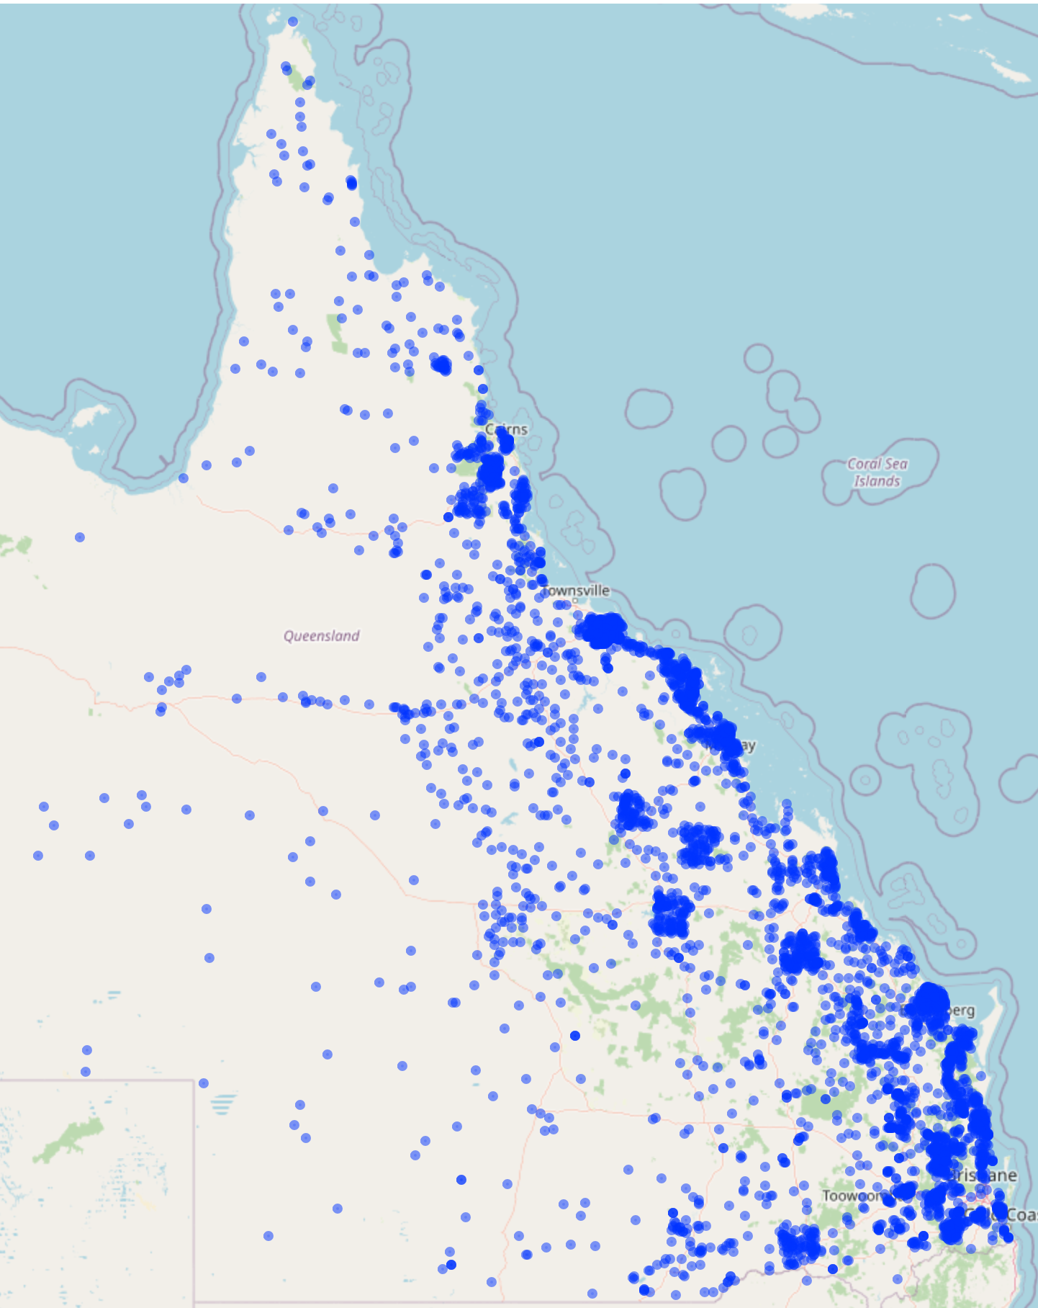
Objectives
Objectives
-- Task 1: classifying ASC & sub orders
ORD
SO
GG
SG
SALI
DATA
TRAINED
ASC
MODEL
√
√
√
√
-- Task 2: clustering & identifying SPC
SPC CLUSTER
TRAINED
SPC CLUSTER
MODEL
SALI
DATA
Nominate A New
SPC
√
OR
Notes:
This project has two main tasks.
In Task 1, our goal is to build a model to learn from existing soil data with a view to classifying ASC and its subclasses.
In Task 2, in order to correlate existing large number of SPCs, an unsupervised hierarchical clustering was performed before applying the similar process as in Task 1.

Slide 5
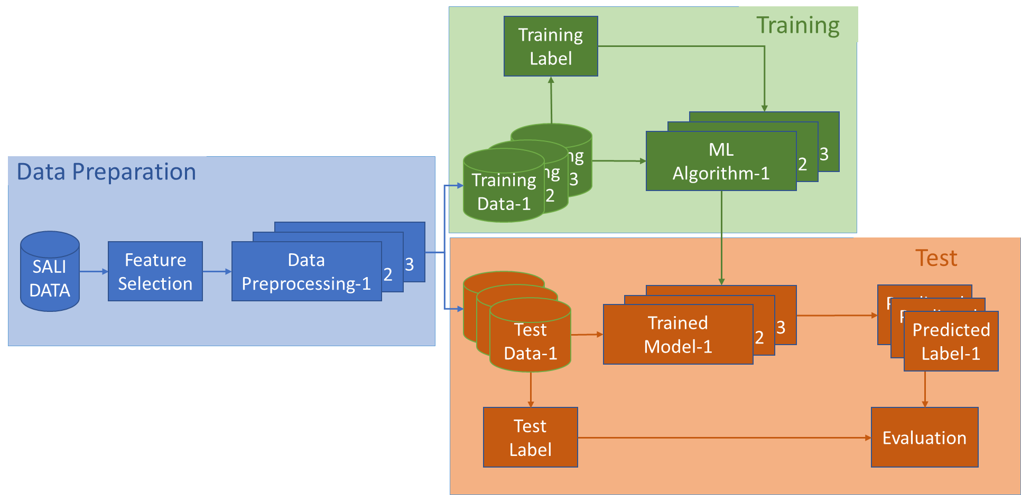
Objectives
TASK 1: ASC Classification
Notes:
The ASC classification task can be summarized into three sections: Data Preparation, Model Training, and Model Testing.

Slide 6
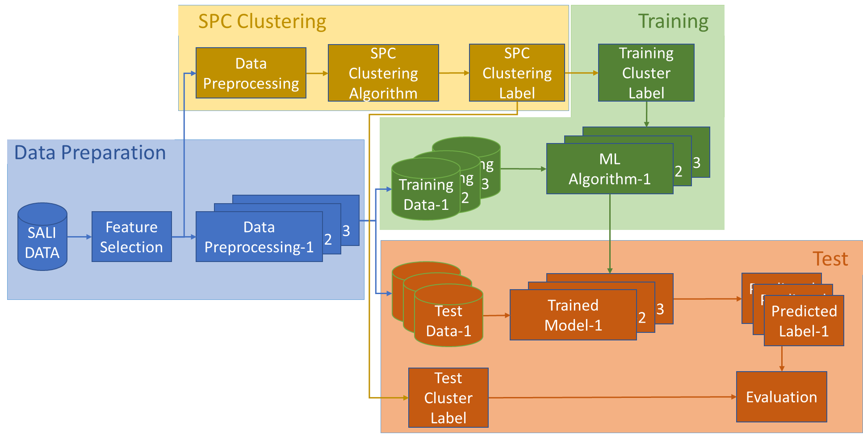
Objectives
TASK 2: SPC Clustering & Identification
Notes:
For the SPC task, a clustering model was added in addition to the three similar sections above.

Slide 7
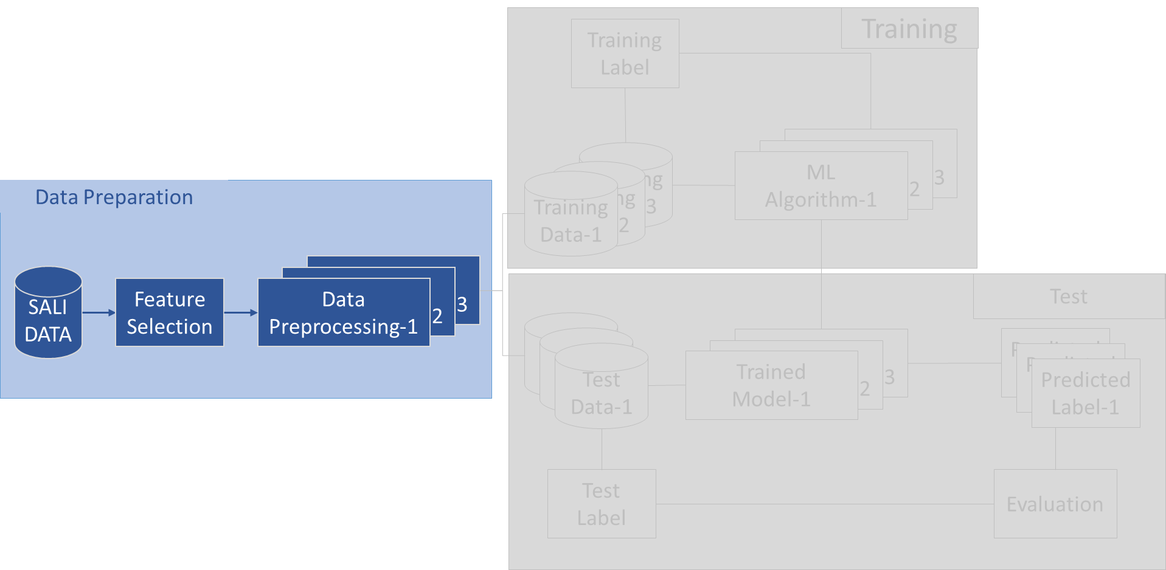
Data Preparation
Objectives
Data Preparation
Notes:
Now, let’s start with the first section.
There is a lot of preparatory work that needs to be done before data can be fed into the model. I will only address three of them here.

Slide 8
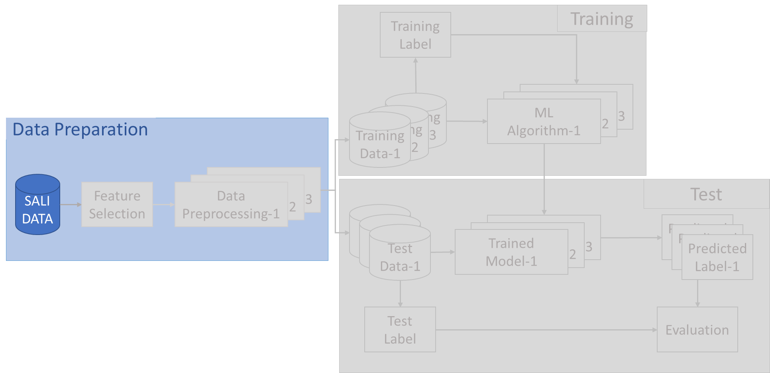
SALI Data
Objectives
Data Preparation
-- SALI Data
Notes:
Firstly, the SALI soil data itself.

Slide 9

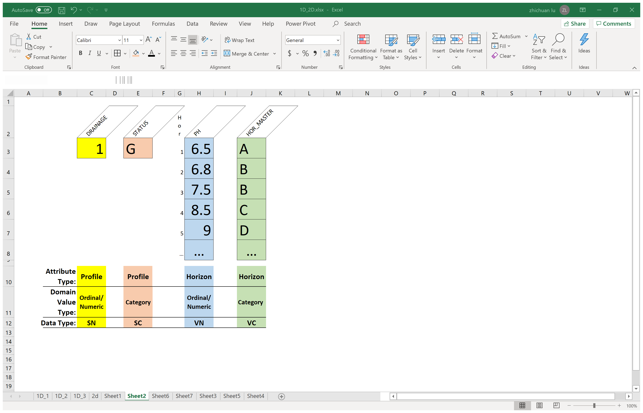
Objectives
SALI Data
Data Preparation
-- SALI Data
-- 2 Attribute types:
Profile layer, Horizon layer
-- 3 Domain Value Types:
Numeric, Ordinal, Nominal/Category
-- 4 Data Types: SN, SC, VN, VC
Initial format of
a single point SALI data
Notes:
SALI data has the following characteristics:
It has two types of attributes: a profile layer and a horizon layer.
both attributes contain three domain value types: Numeric, Ordinal, and Categorical.
Since ordinal values can always find a way to convert them to numerical values, SALI Data can be defined as four data types:
Profile numerical/ordinal attributes as SN,
Profile categorical attributes as SC,
Horizon numerical/ordinal attributes as VN,
And Horizon categorical attributes as VC.
Based on this understanding, an initial single-point SALI data format has been developed.
It consists of multiple rows of HORIZON data and can be considered as a two-dimensional data with horizons and attributes as two dimensions.

Slide 10
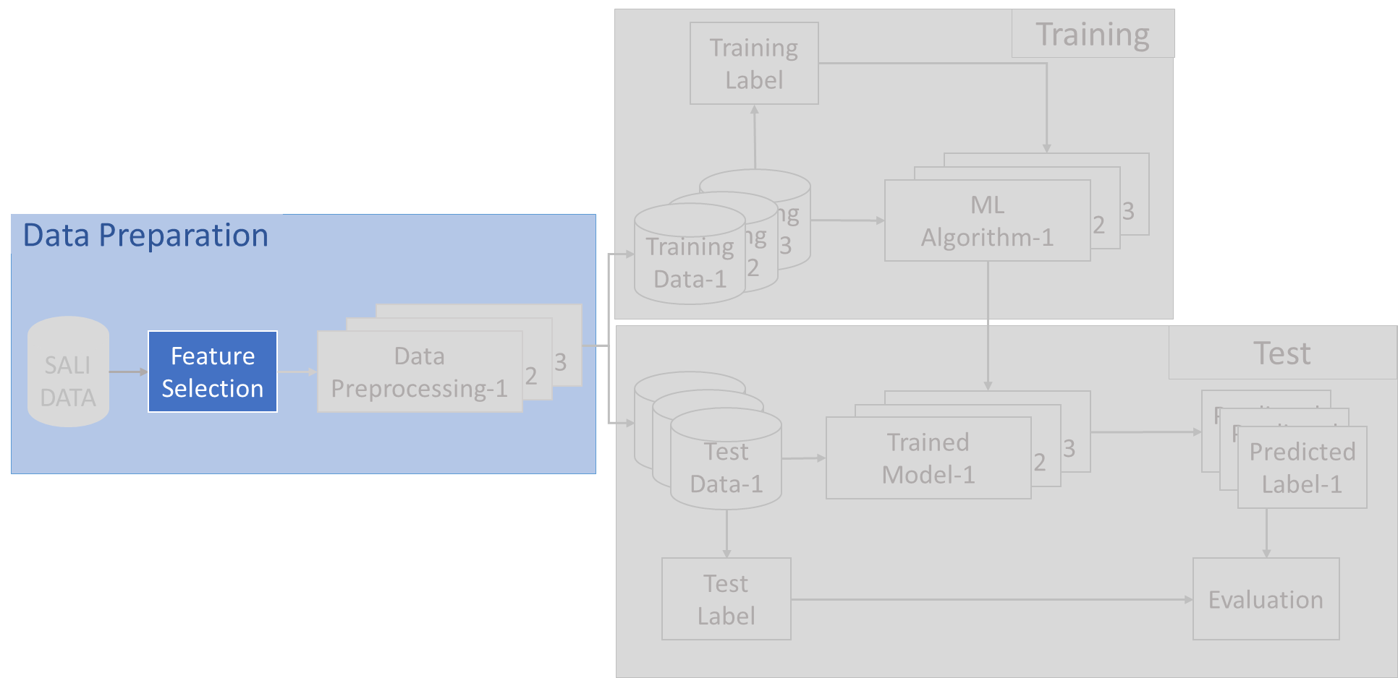
Feature Selection
Objectives
Data Preparation
-- SALI Data
-- Feature Selection
Notes:
The second one is feature selection

Slide 11
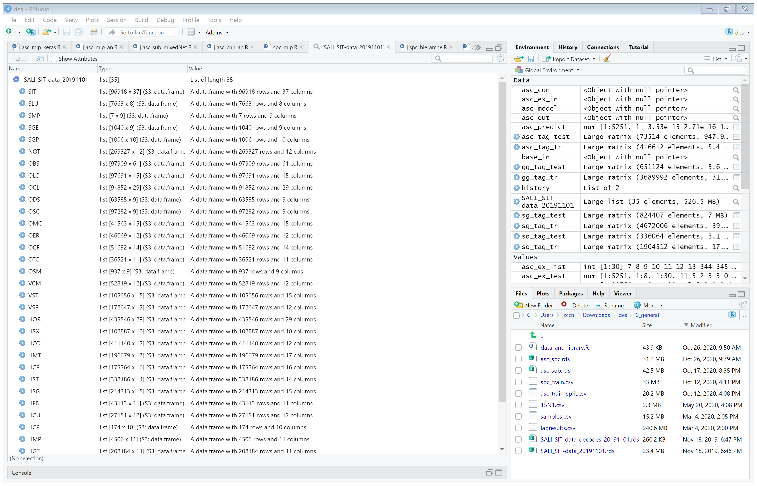
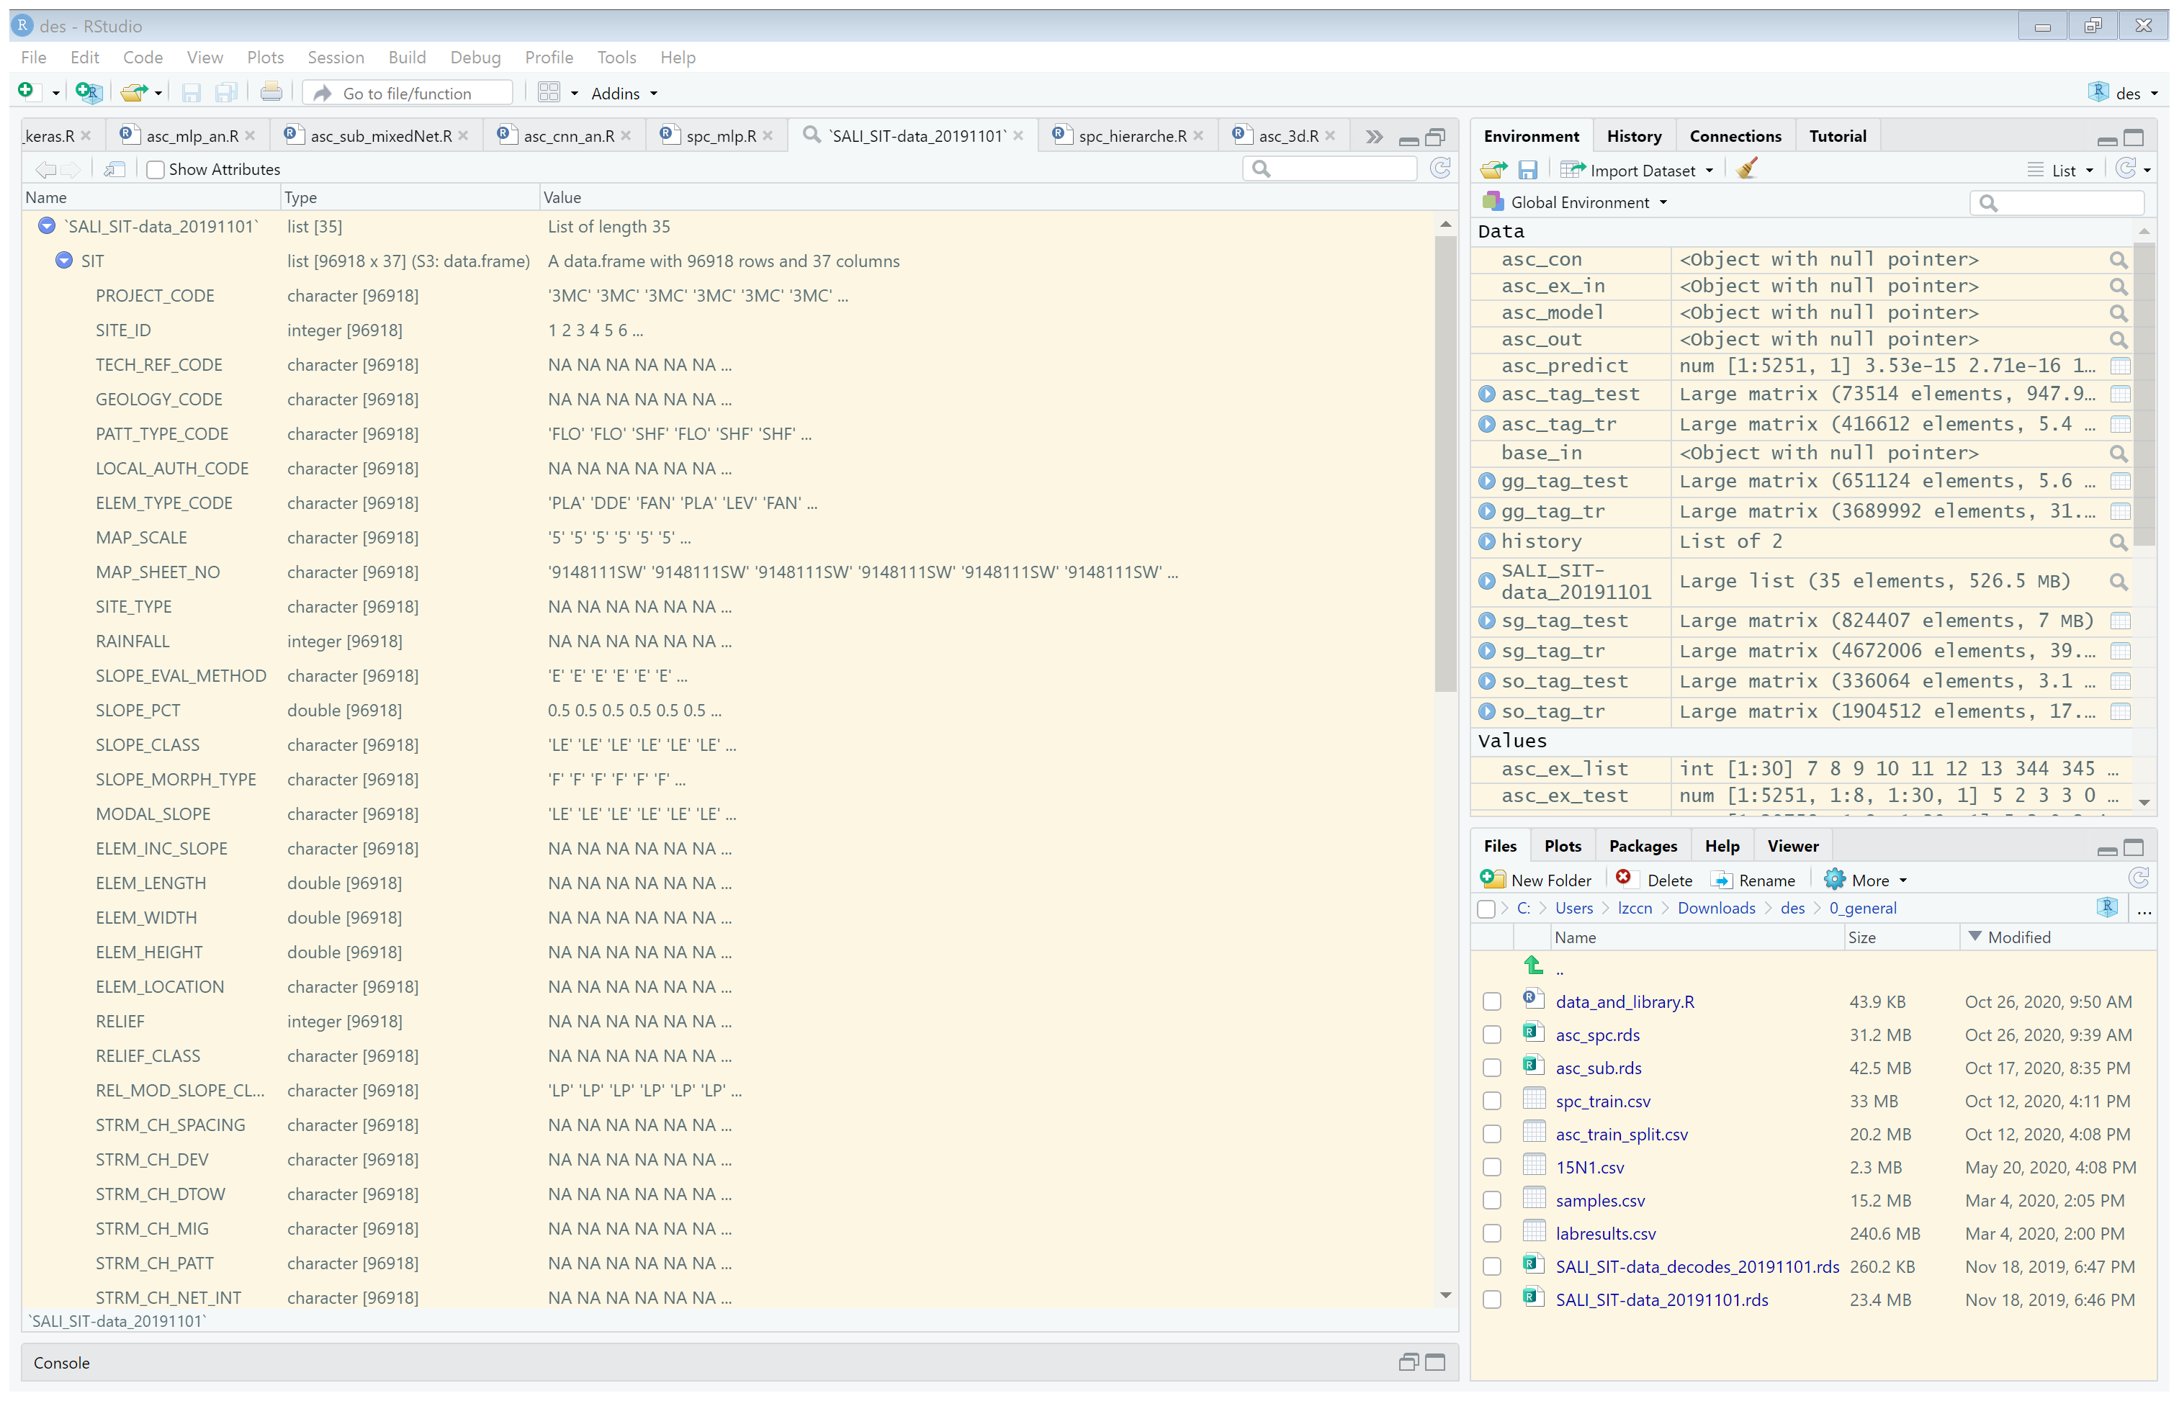
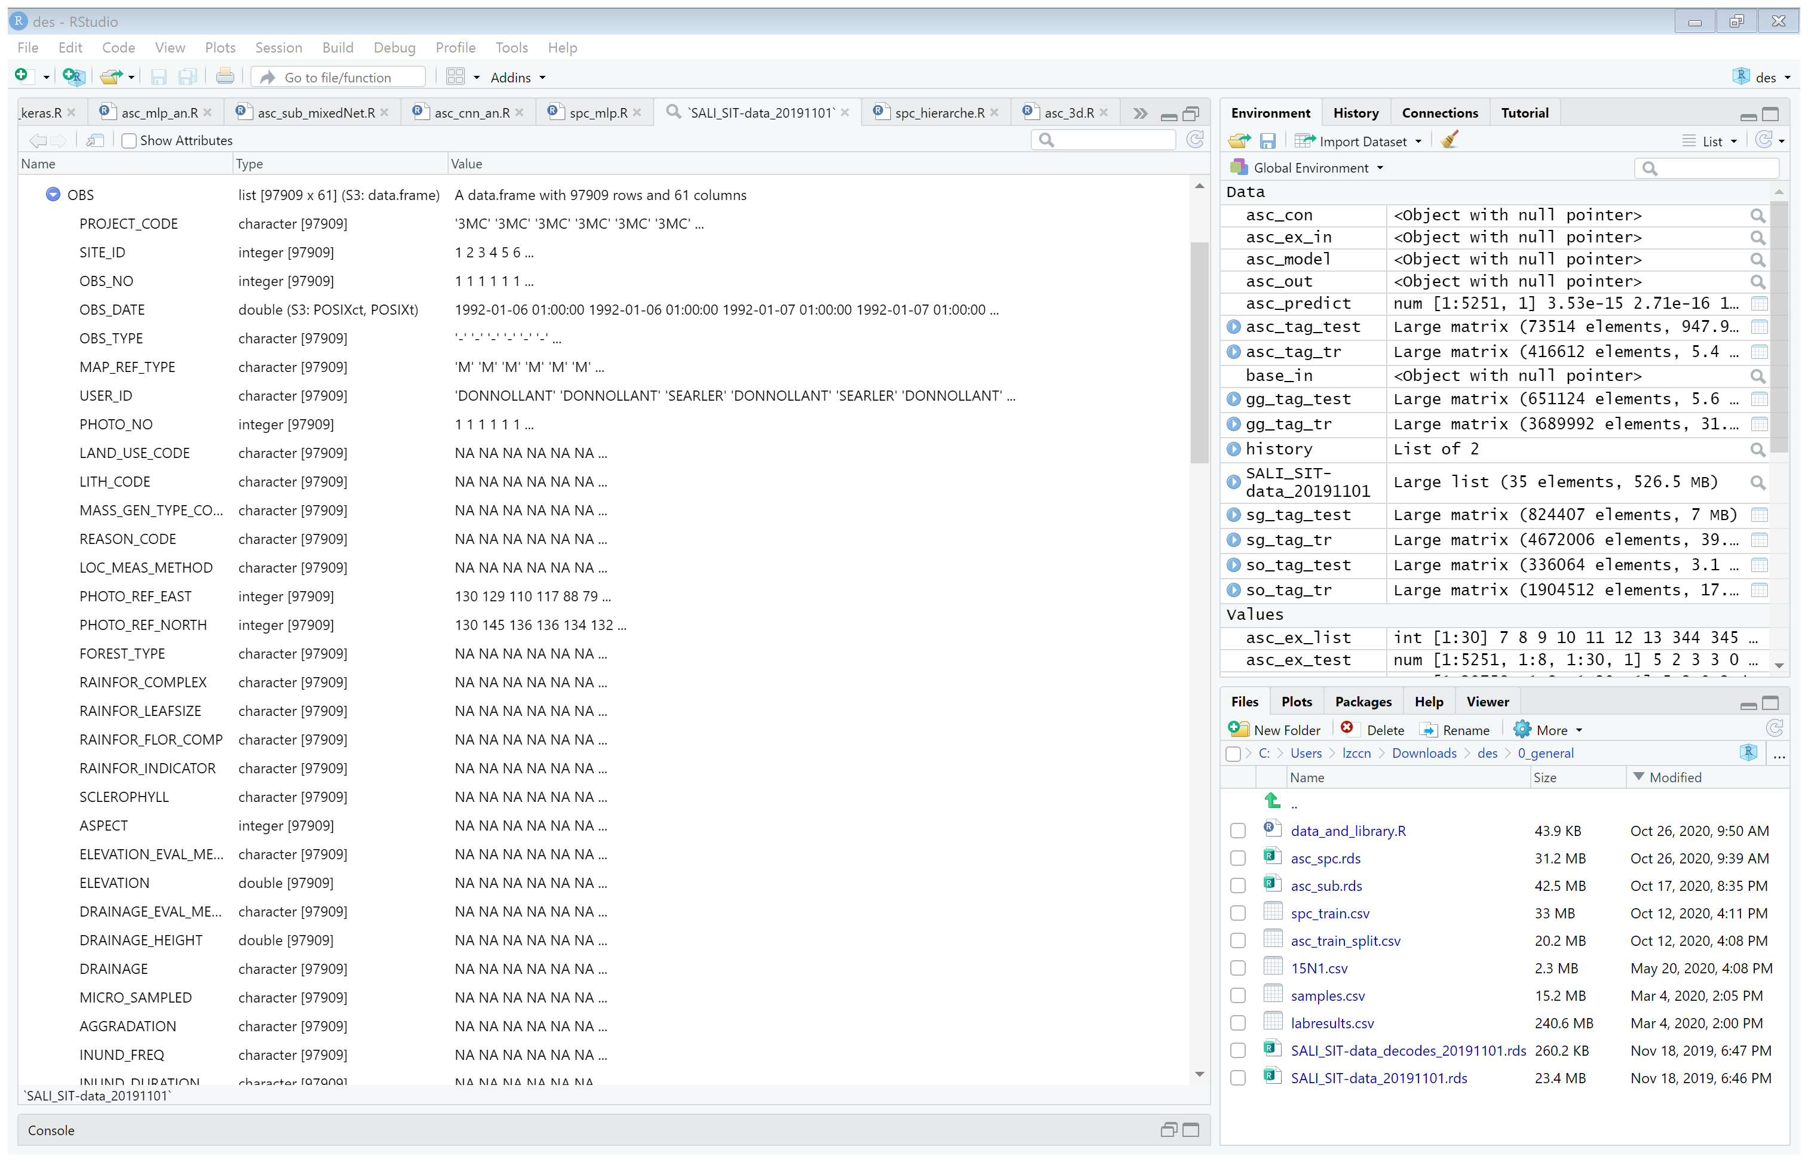
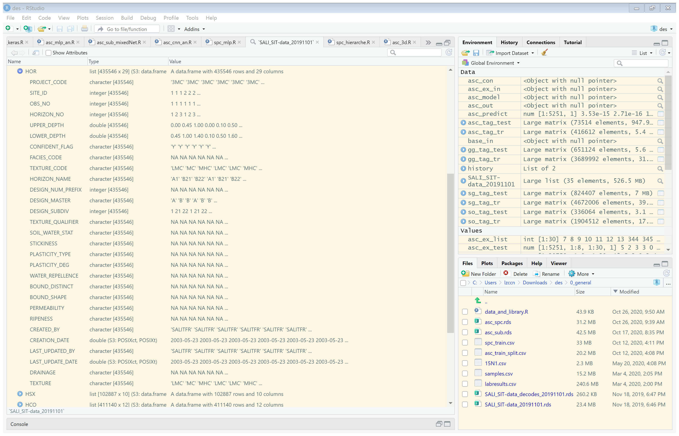
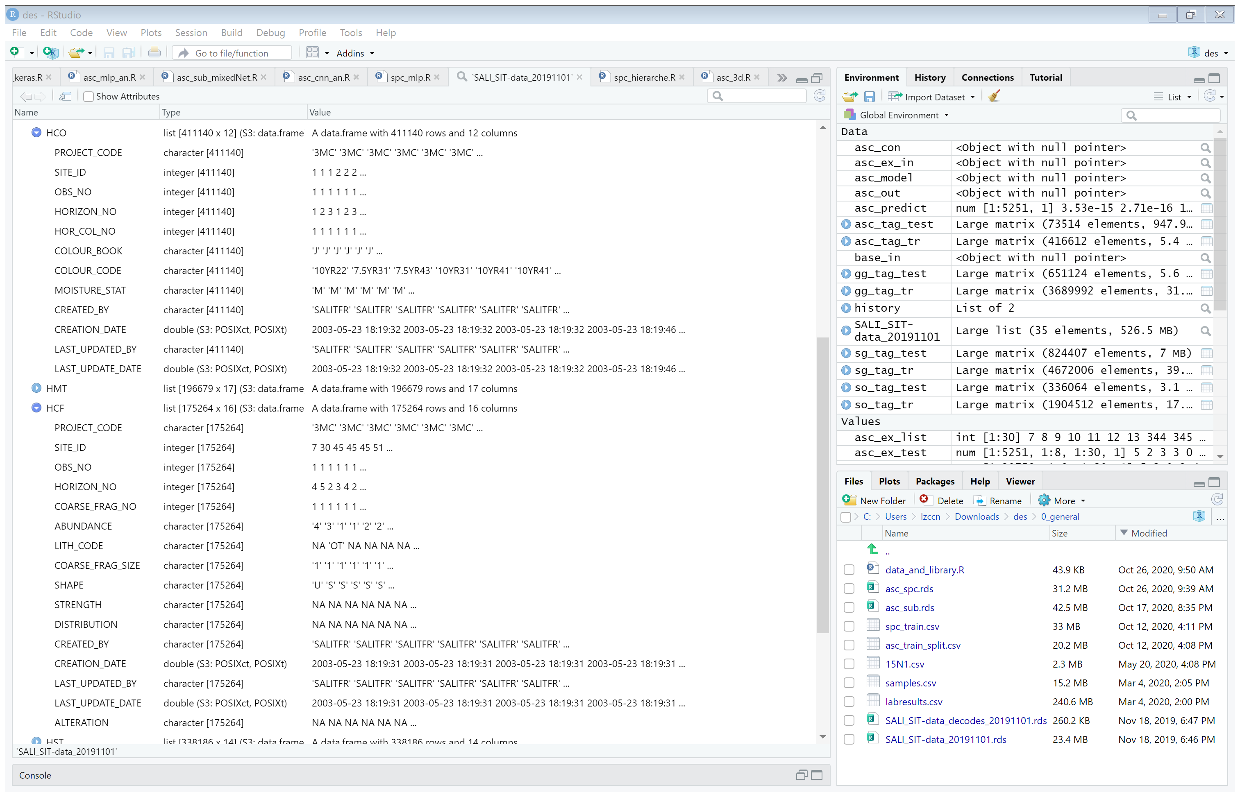
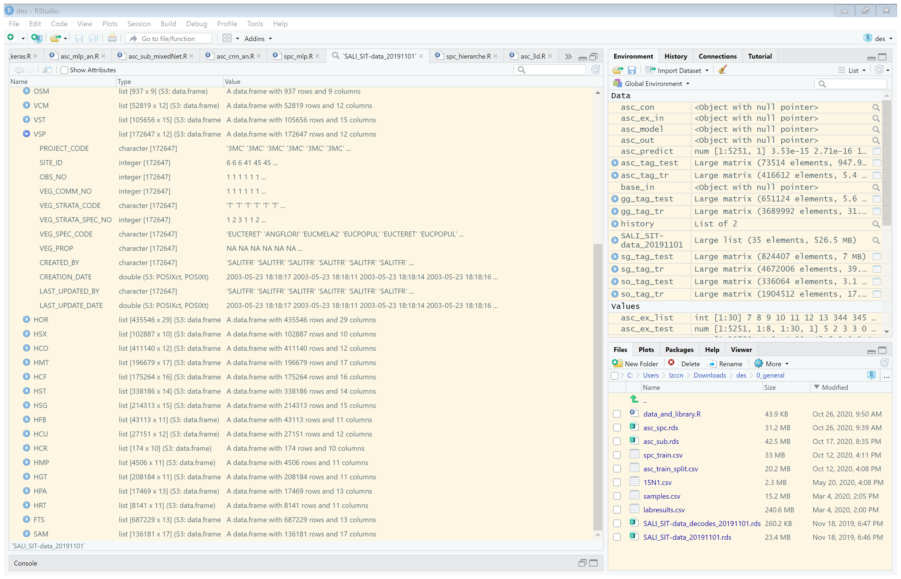


Feature Selection
Objectives
Data Preparation
-- SALI Data
-- Feature Selection
Notes:
SALI data contains hundreds of attributes, feature selection is necessary to make the workflow and overall performance greater.

Slide 12
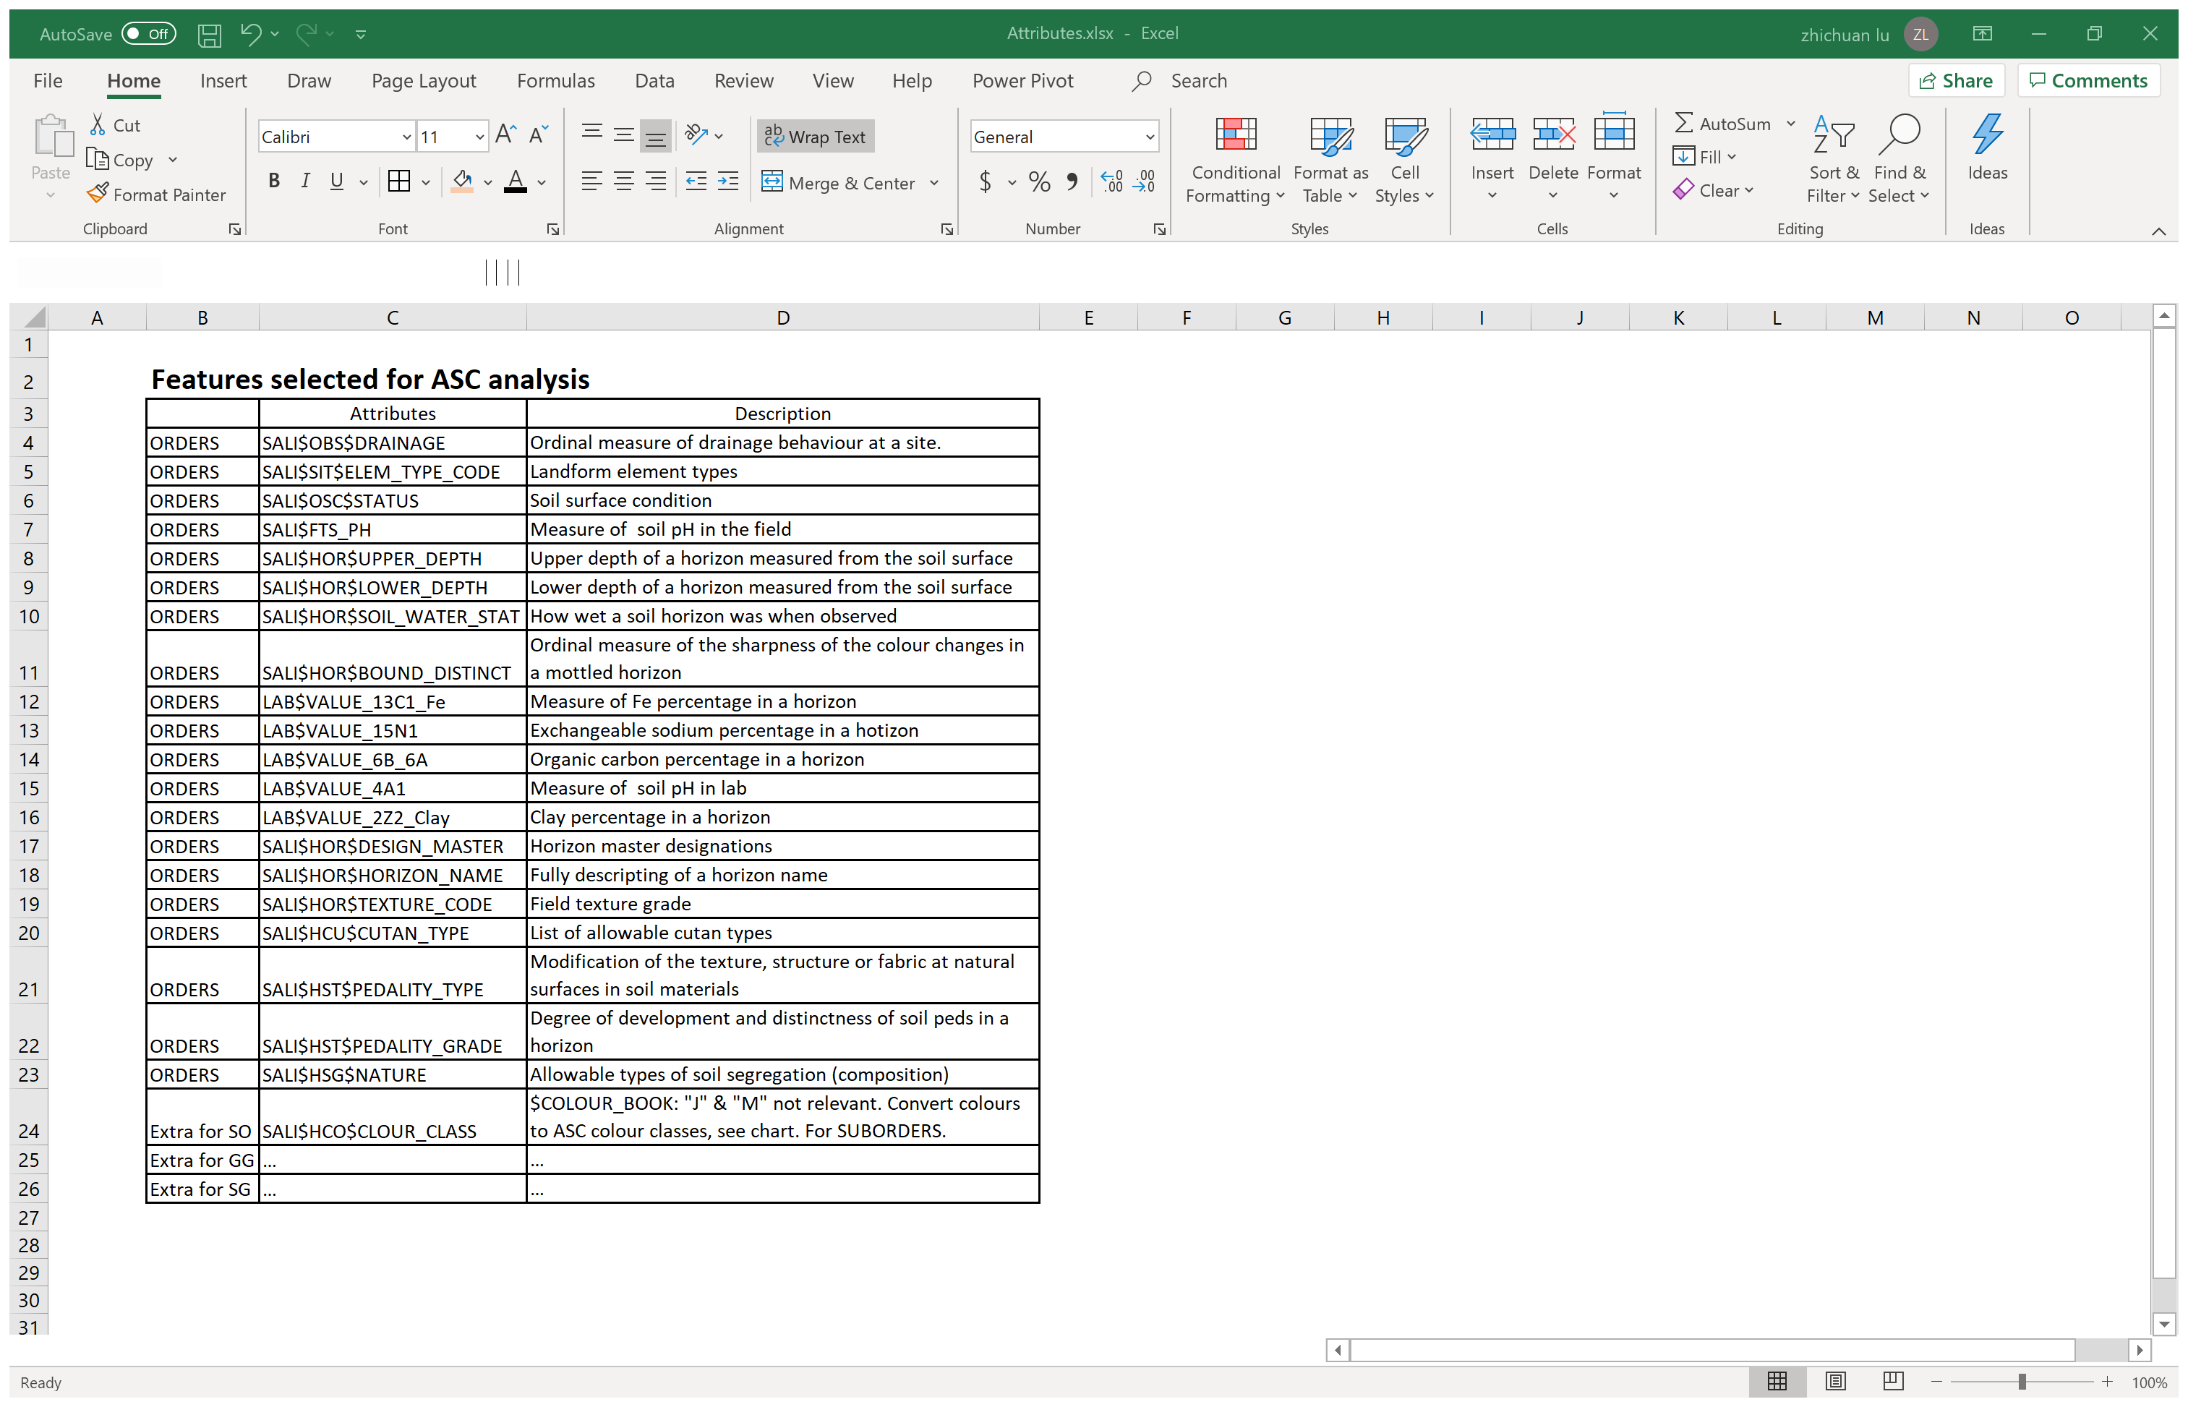
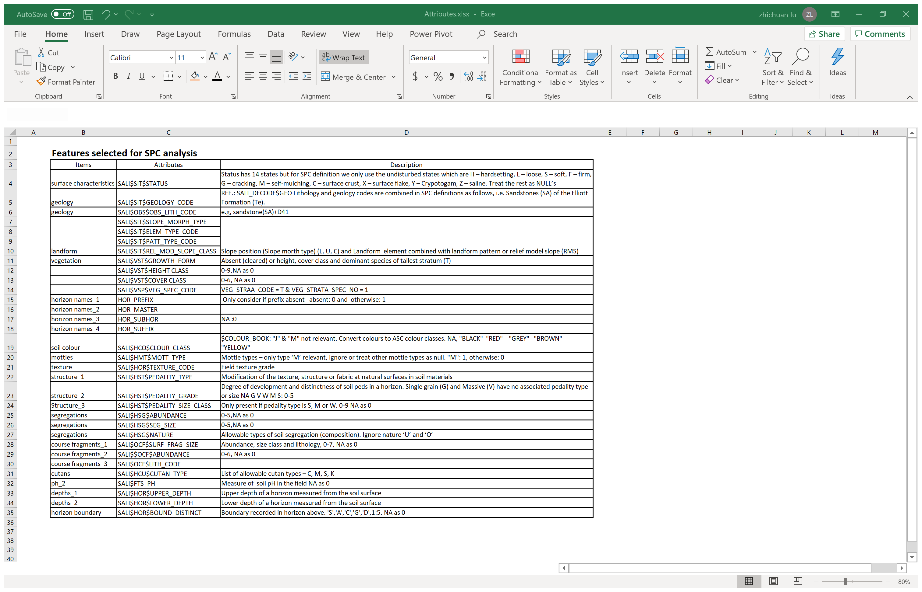
Feature Selection
Objectives
Data Preparation
-- SALI Data
-- Feature Selection
Notes:
Thanks to my supervisors, Peter, Evan, and Max,
expert knowledge-based feature selection is applied to extract attributes for the analysis of ASC and SPC.
In particular, the mix of field and lab attributes are selected for ASC analysis . However, only field attributes are used in SPC analysis.

Slide 13
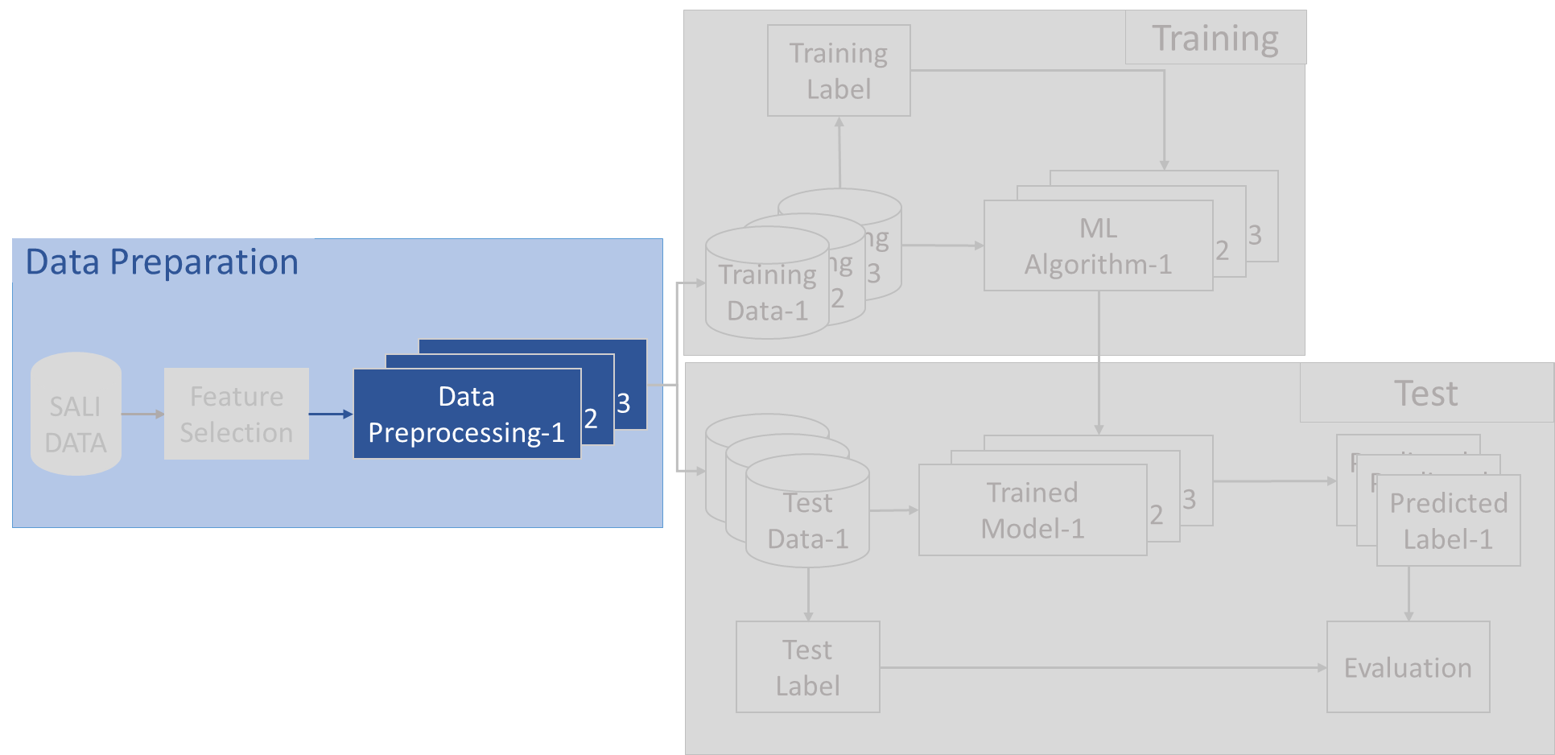
Data Preprocessing
Objectives
Data Preparation
-- SALI Data
-- Feature Selection
-- Data Preprocessing
Notes:
After the attributes are selected, various data pre-processing will be implemented according to the needs of various algorithms.
In this presentation, I mainly focus on the processing for NN models.

Slide 14
Data Preprocessing
Objectives
Data Preparation
-- SALI Data
-- Feature Selection
-- Data Preprocessing
1. Data transformations
Notes:
The first thing to consider is data transformations.

Slide 15
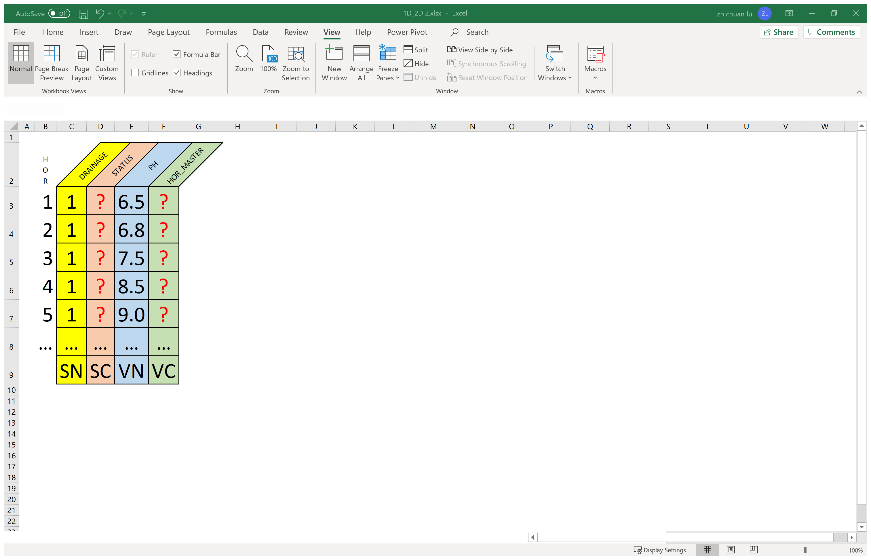
Data Transformations -- 2D Transformations
Objectives
Data Preparation
-- SALI Data
-- Feature Selection
-- Data Preprocessing
Initial format of
a single point SALI data
Notes:
Let's start with the initial format of a single SALI data, which is a two-dimensional data that includes numerical and categorical values. Generally, in most cases and certainly in neural network’s case, categorical values need to be converted to numerical values.
Humans are easy to recognize text, but it's never easy for machines. One-hot encoding or entity embedding can be applied to perform this conversion.

Slide 16
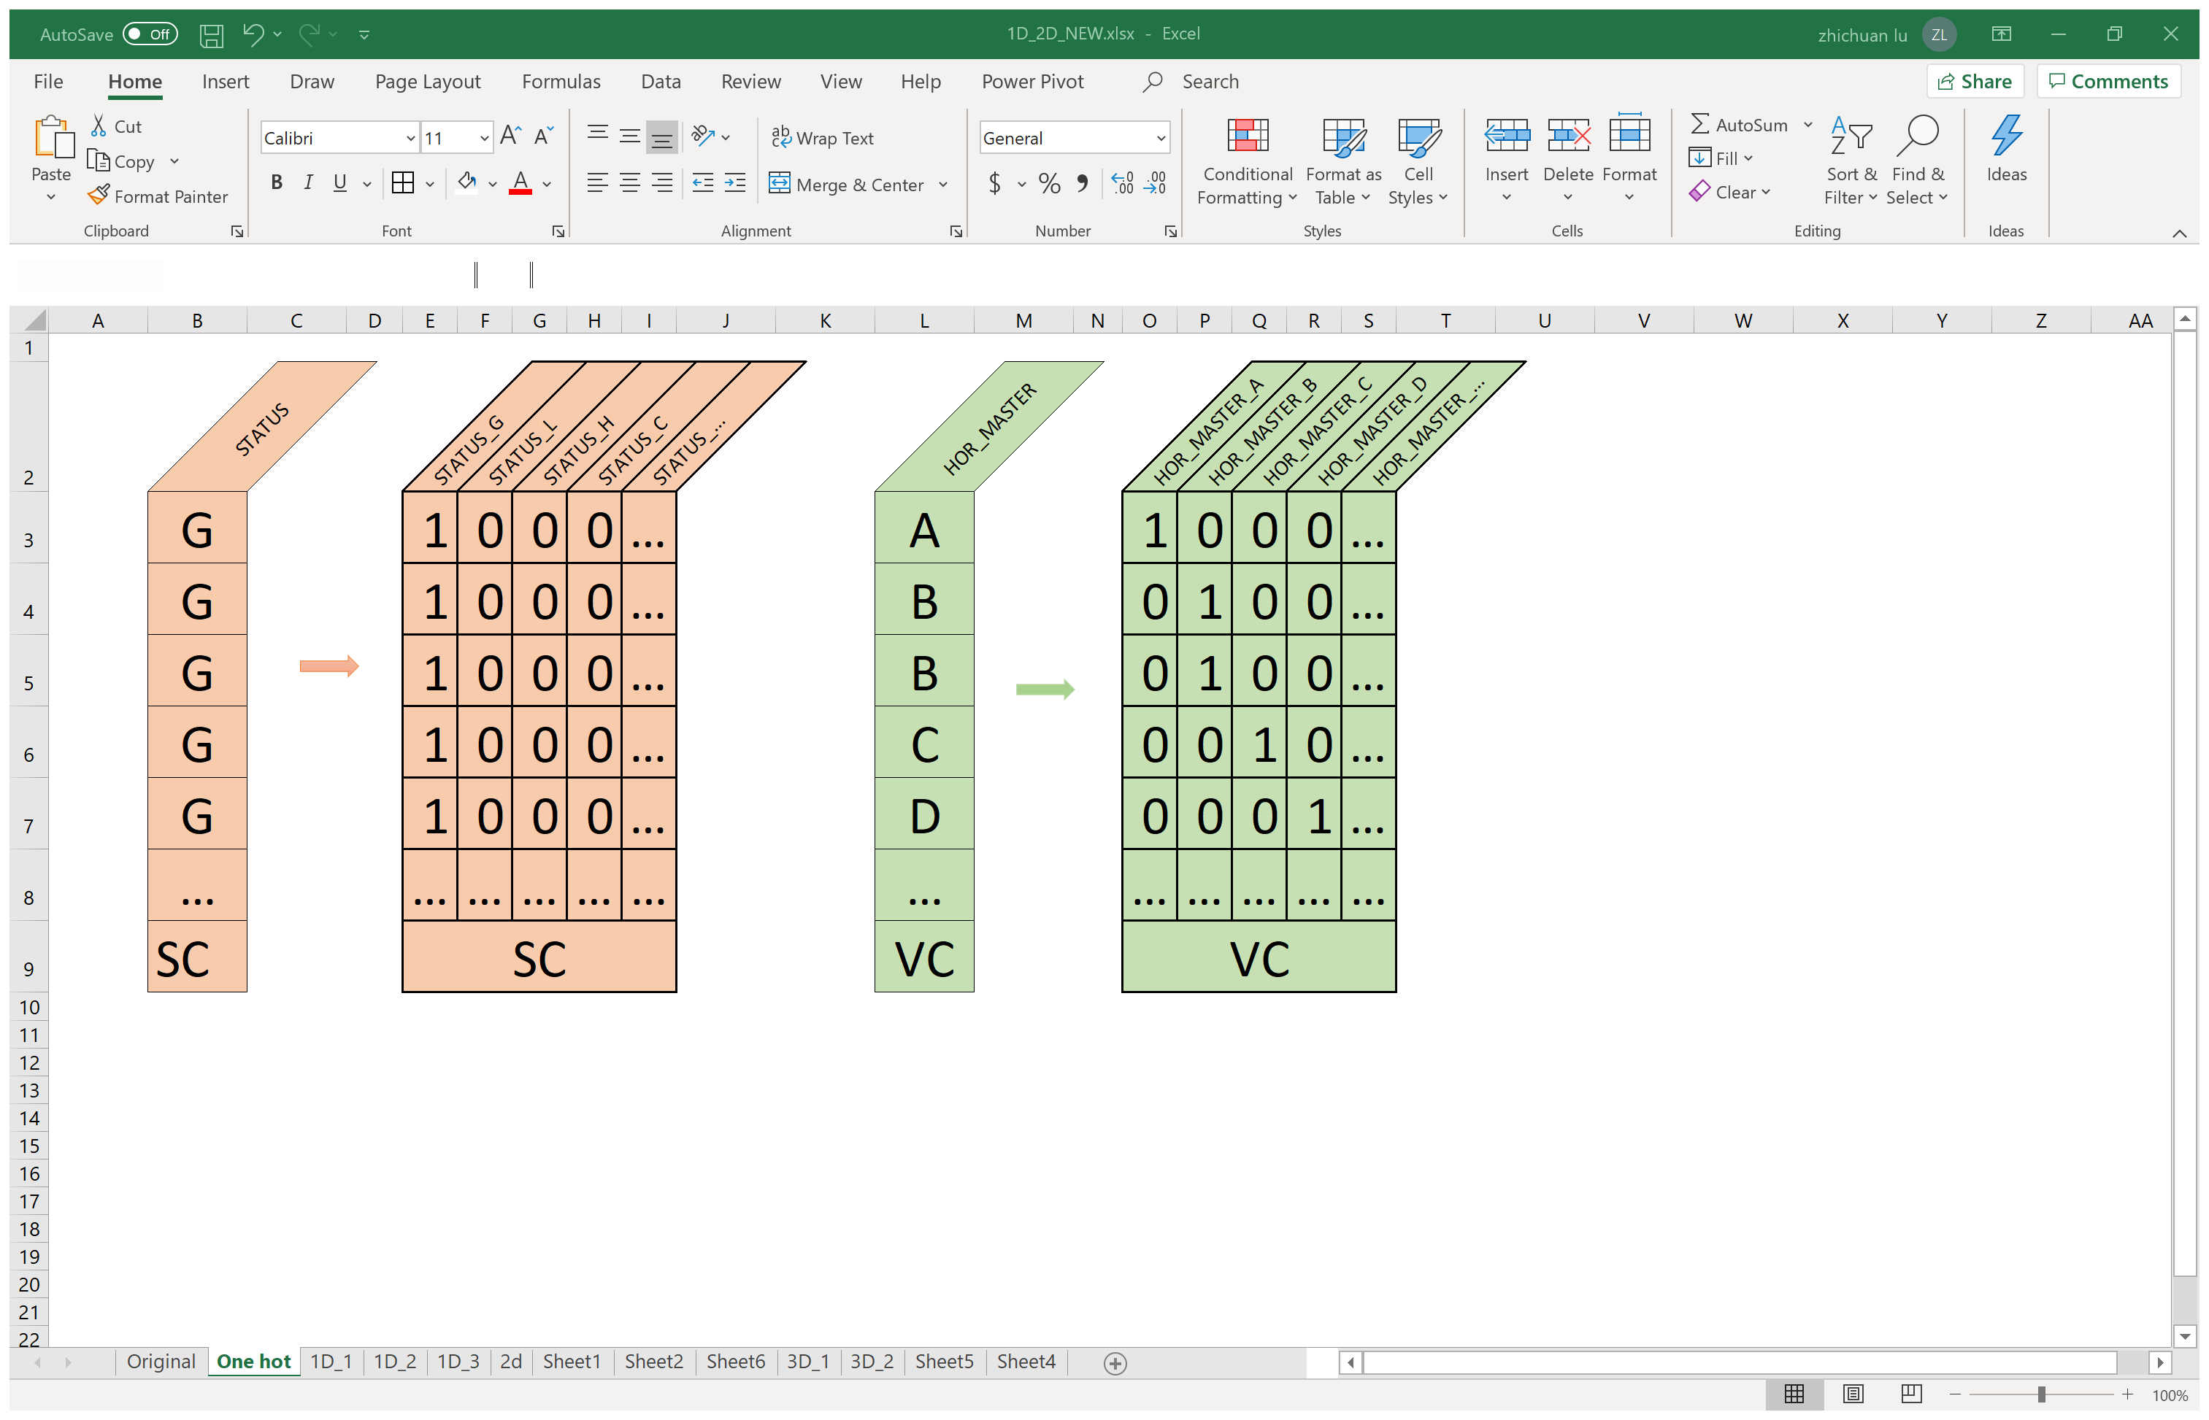
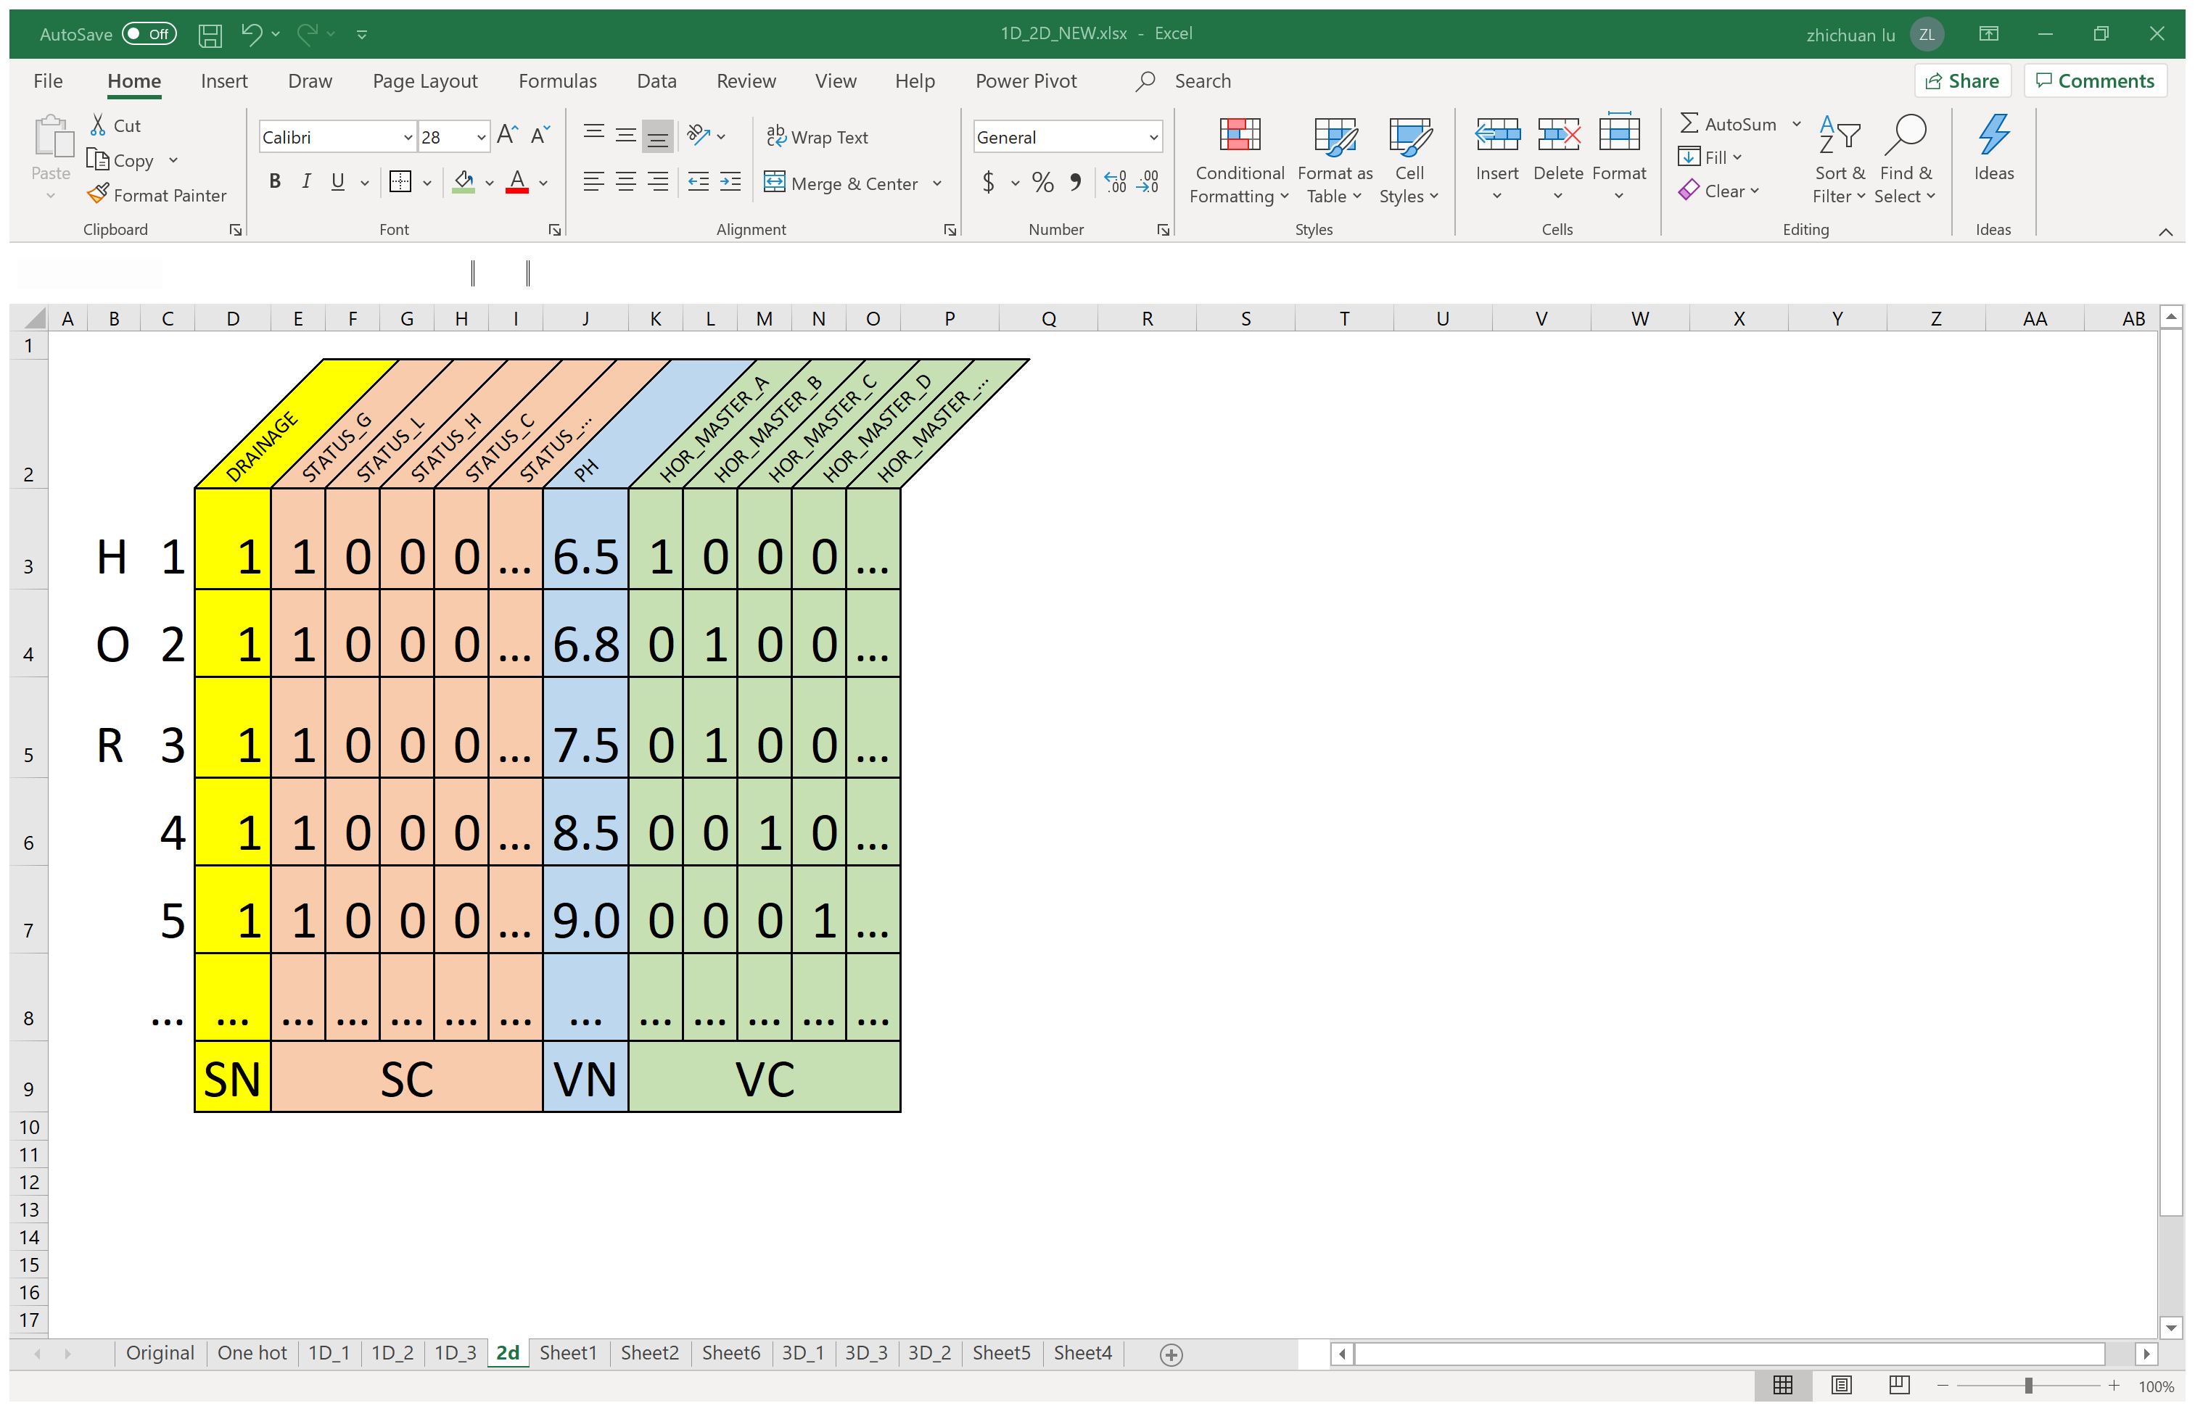
Data Transformations -- 2D Transformations
Objectives
Data Preparation
-- SALI Data
-- Feature Selection
Initial format of
a single point SALI data
One Hot encoding
2D transformation:
-- Data Preprocessing
Notes:
One-hot encoding uses a 0-1 binary vector to represent each domain value in categorical attributes. Each unique domain value will become a new attribute, and the one with the nominated domain value will be marked as 1, and the others as 0.
This flowchart demonstrates a one-hot encoded 2D to 2D transformation. The output 2D format data is composed of pure numeric values and can be used as input to a neural network model.

Slide 17
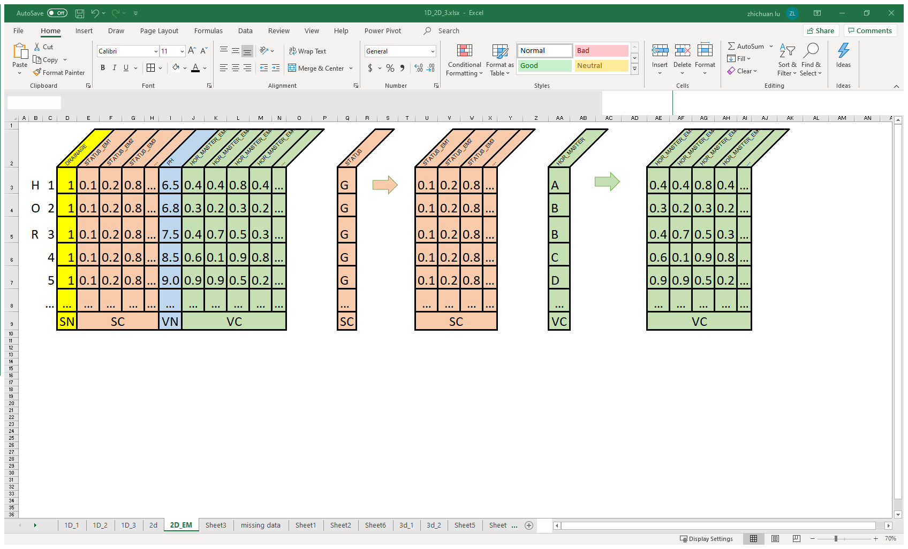
Objectives
Data Preparation
Data Transformations -- 2D Transformations
-- SALI Data
-- Feature Selection
Initial format of
a single point SALI data
Entity Embedding
2D transformation:
-- Data Preprocessing
Notes:
In the second approach, entity embedding will also generate a vector value for each domain value of the categorical attributes.
But unlike the 0-1 binary vector of one hot encoding, the values in the embedding vector will be distributed in a preset range (such as between 0 and 1),
and because of this, the vector length can be much smaller than the results produced by One-hot encoding, this is very helpful for attributes with a large number of domain values.
Furthermore, embedding vector’s values are not fixed, and they would be adjusted and optimized during model training.

Slide 18
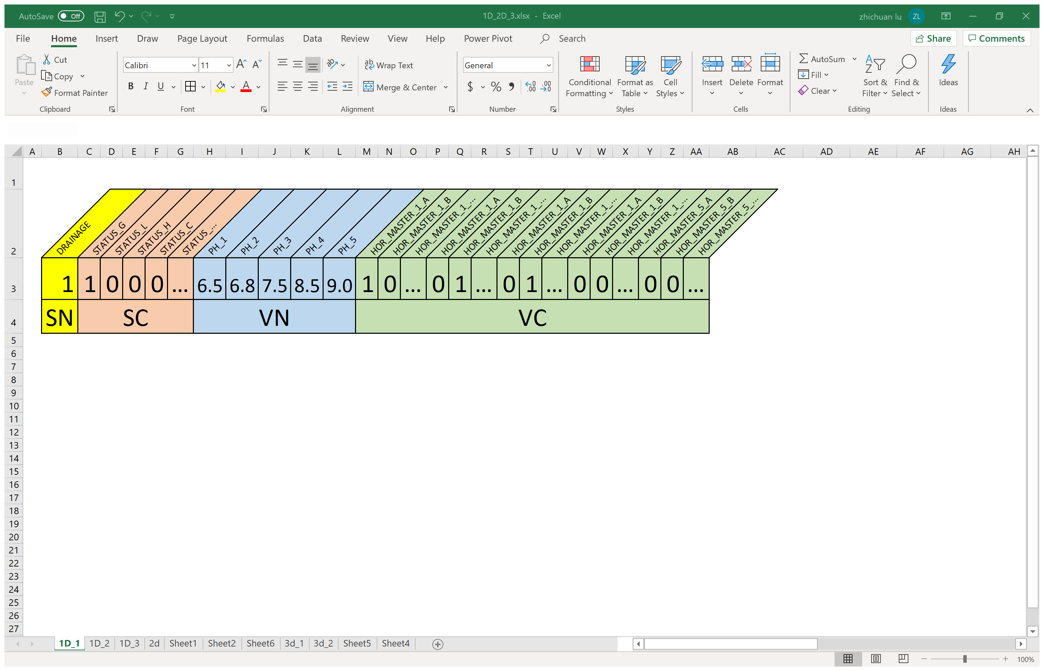
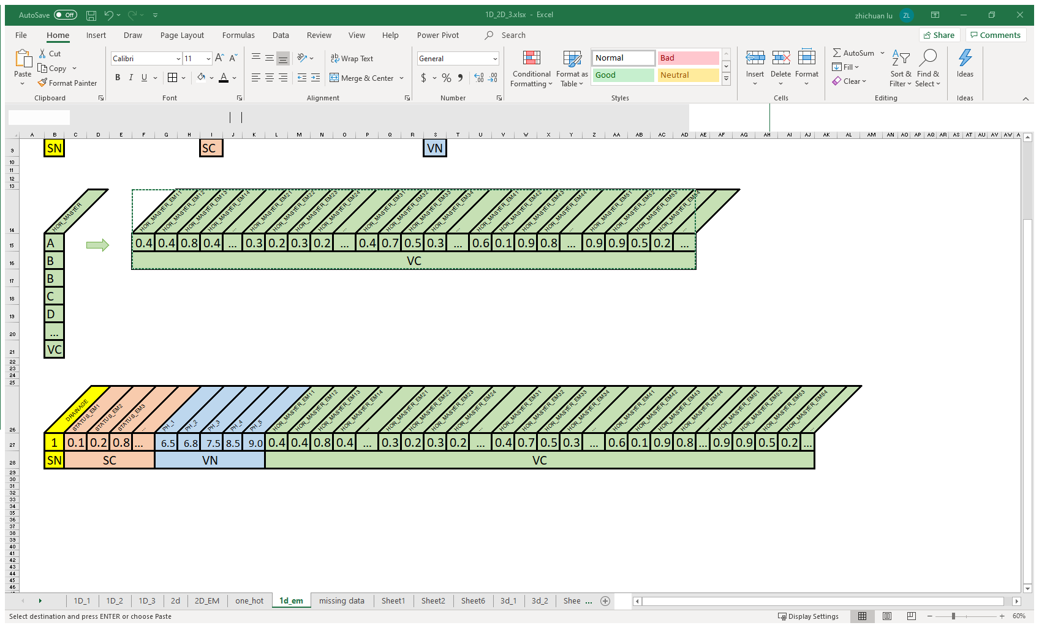
Objectives
Data Preparation
Data Transformations -- 1D Transformations
-- SALI Data
Initial format of
a single point SALI data
-- Feature Selection
One Hot Encoding & Row - Column Conversion
-- Data Preprocessing
Entity Embedding & Row - Column Conversion
Notes:
However, the most common input to the model is one-dimensional data.

Slide 19
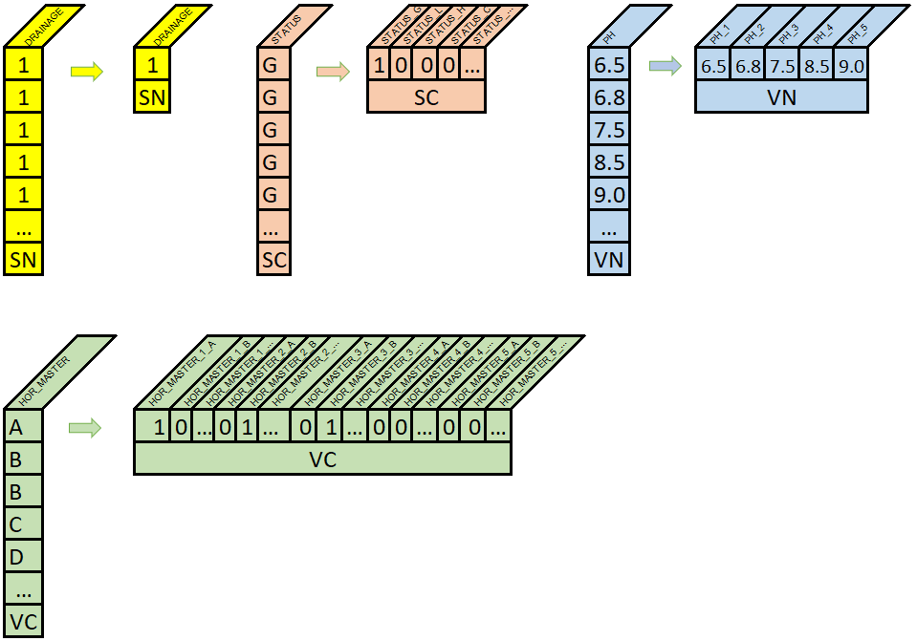
Objectives
Data Preparation
Data Transformations -- 1D Transformations
-- SALI Data
Initial format of
a single point SALI data
-- Feature Selection
One Hot Encoding & Row – Column Conversion
-- Data Preprocessing
One Hot Encoding
row - column conversion
One Hot Encoding +
row - column conversion
Notes:
One-hot encoding

Slide 20
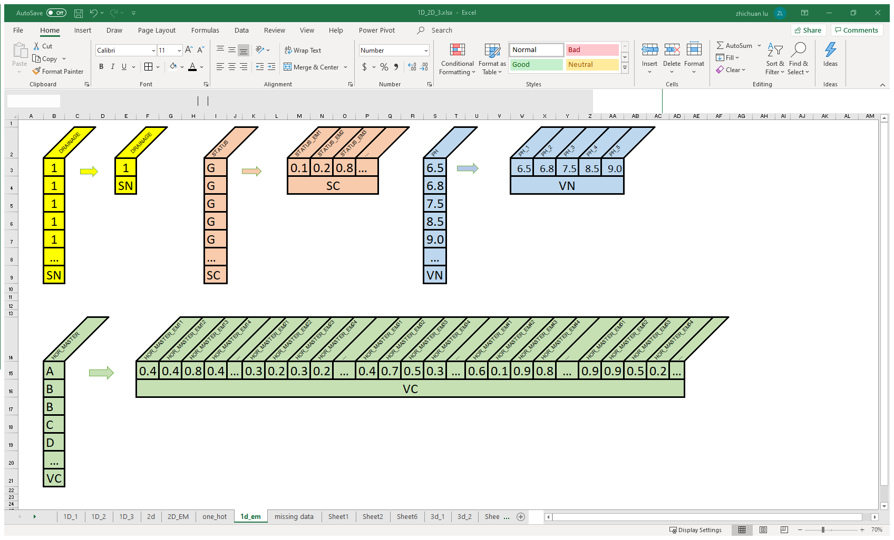
Objectives
Data Preparation
Data Transformations -- 1D Transformations
-- SALI Data
Initial format of
a single point SALI data
-- Feature Selection
Entity Embedding & Row - Column Conversion
-- Data Preprocessing
Entity Embedding
row - column conversion
One Hot Encoding +
row - column conversion
Notes:
or entity embedding combined with row-to-column conversion would achieve the 2D – 1D transformation.

Slide 21
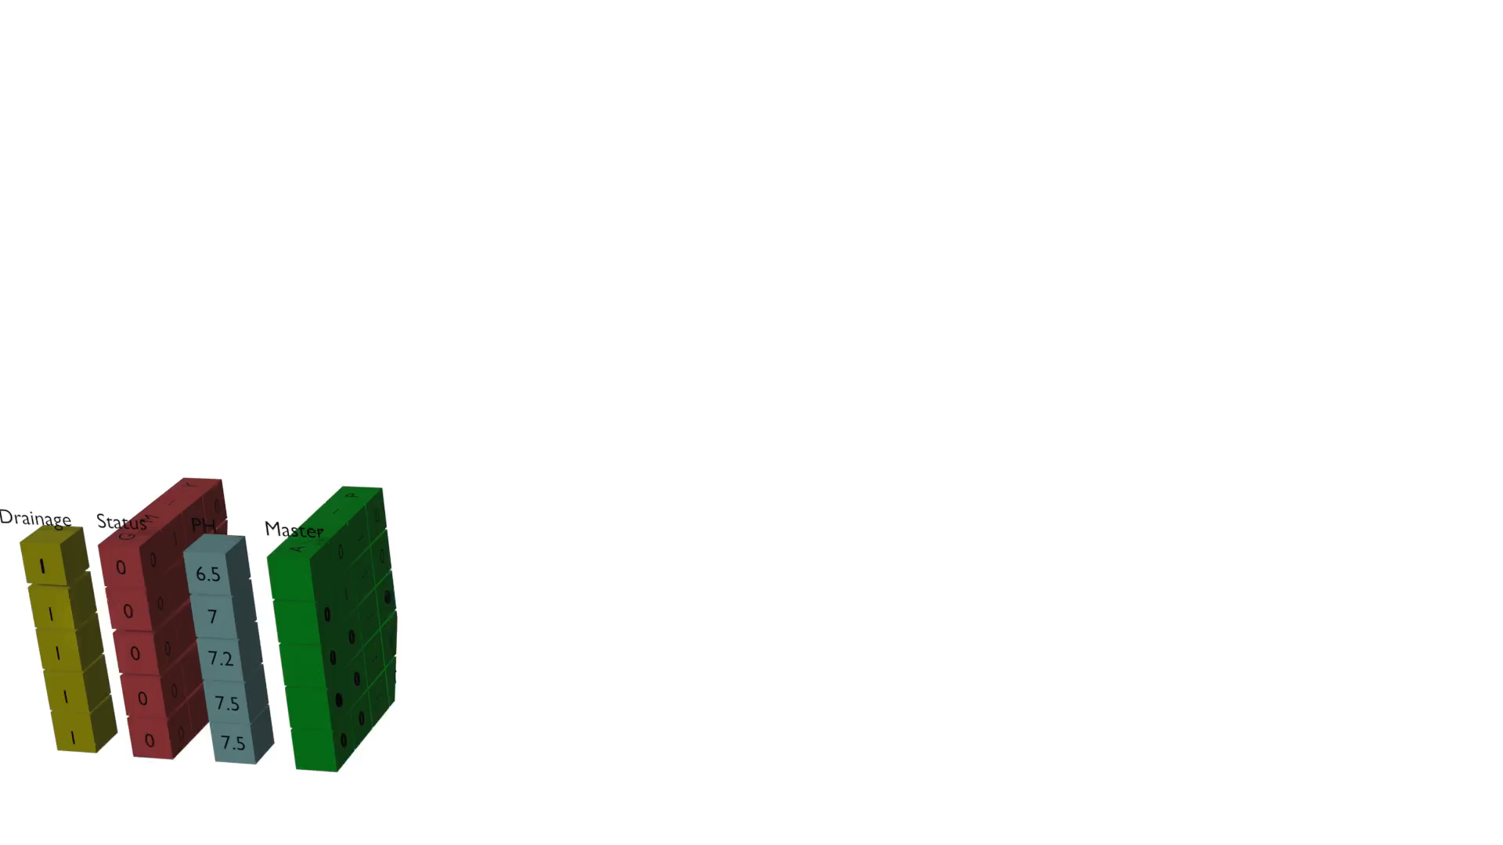
Data Transformations
Objectives
Data Preparation
-- SALI Data
-- Feature Selection
-- Data Preprocessing
Notes:
My 12-year-old son helped me to create this video to illustrate how 2D data converts to 1D data.
He asked me to cite it in my reference however I didn’t have it in this presentation, so I gave him the credit here!!!
From here you can see:
Profile attributes will drop off redundant horizon rows, because they all the same
Categorical attributes will perform oneHot encoding or entity embedding
Also, horizon attributes will do a row to column conversion to generate a 1D data

Slide 22
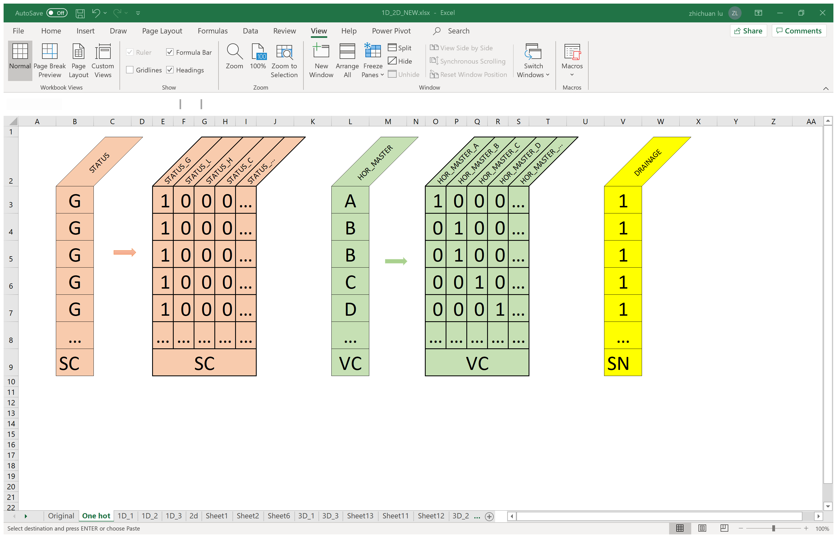
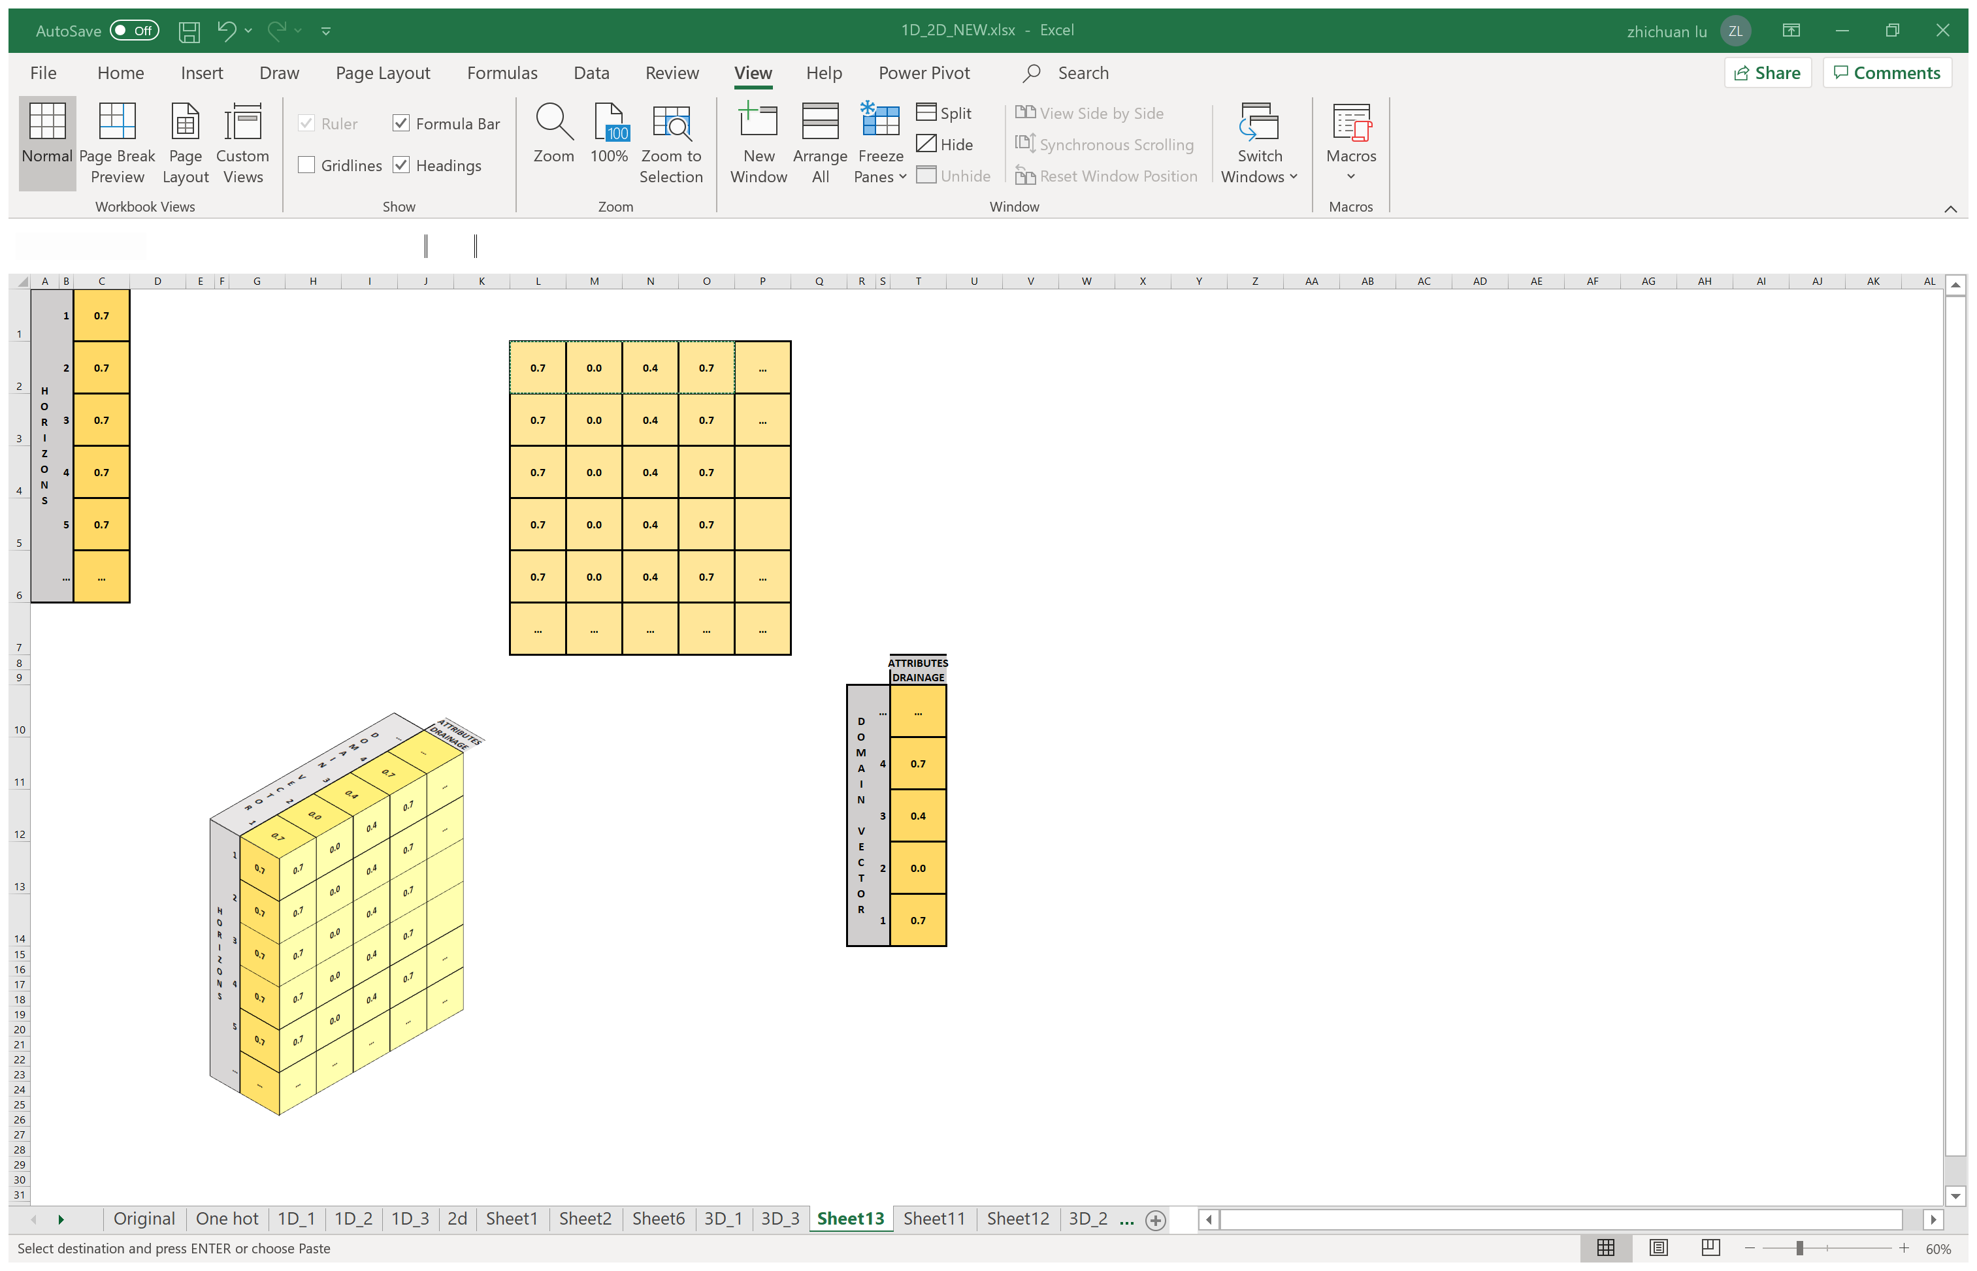
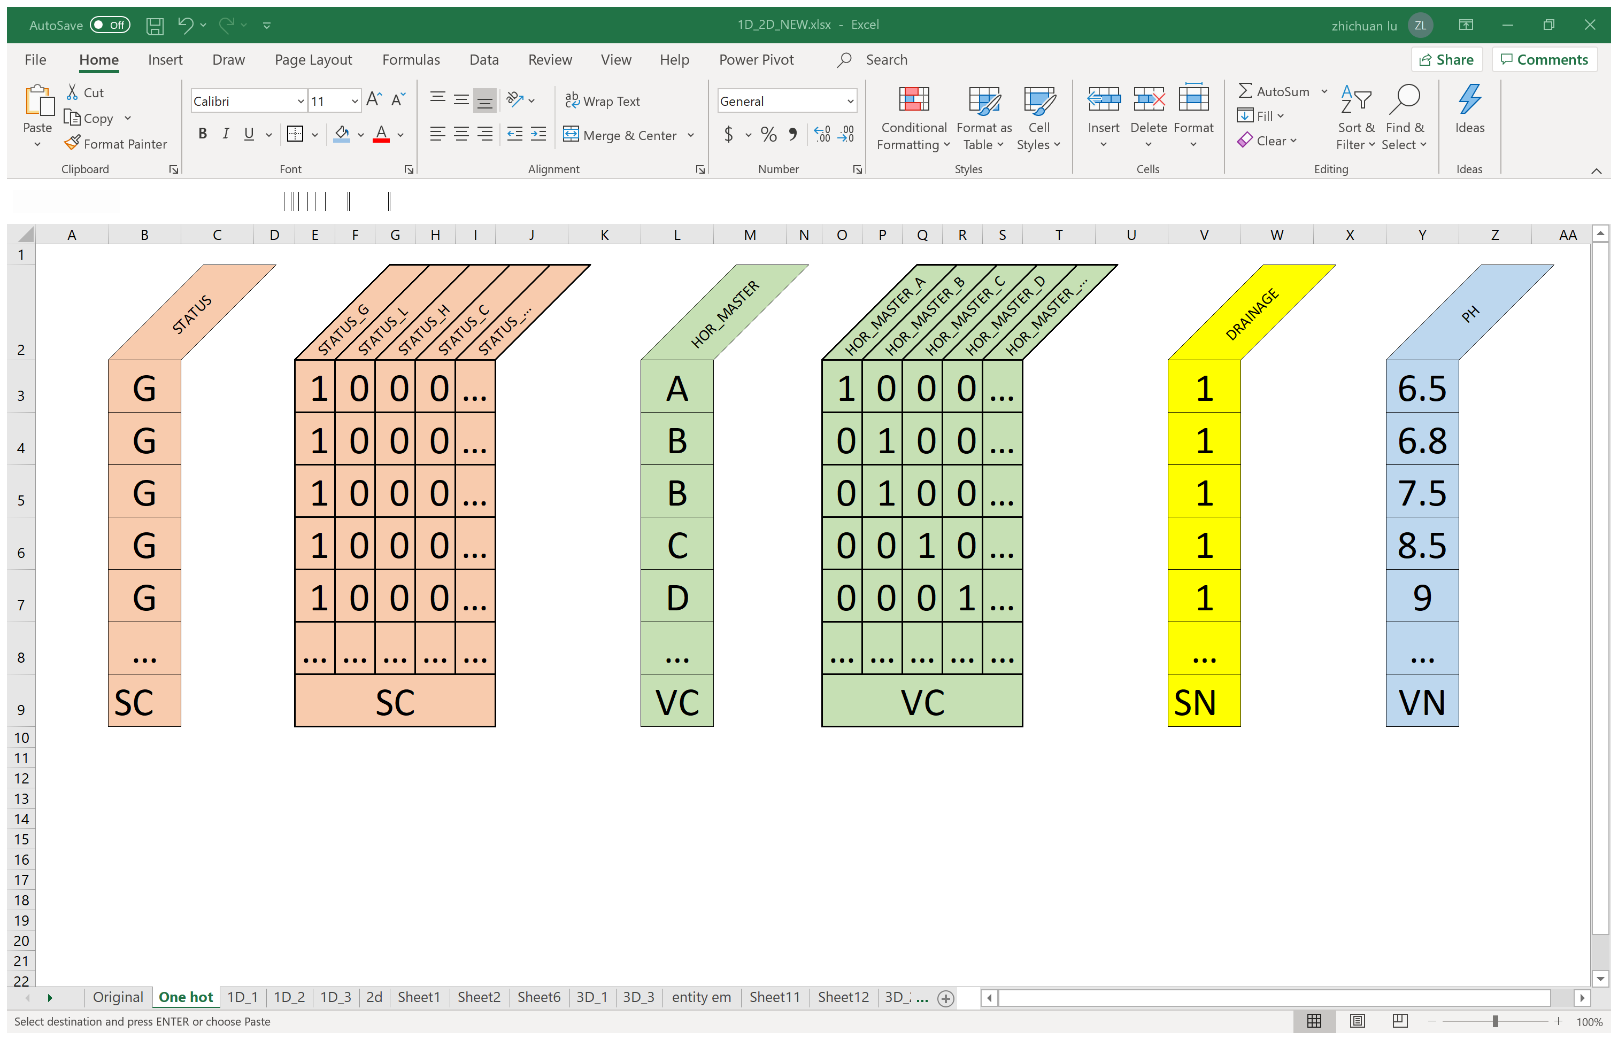
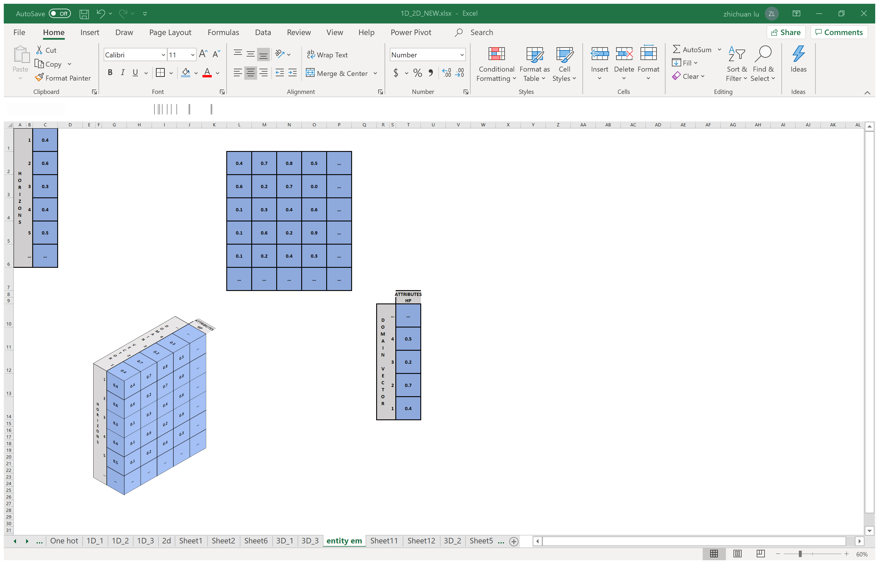
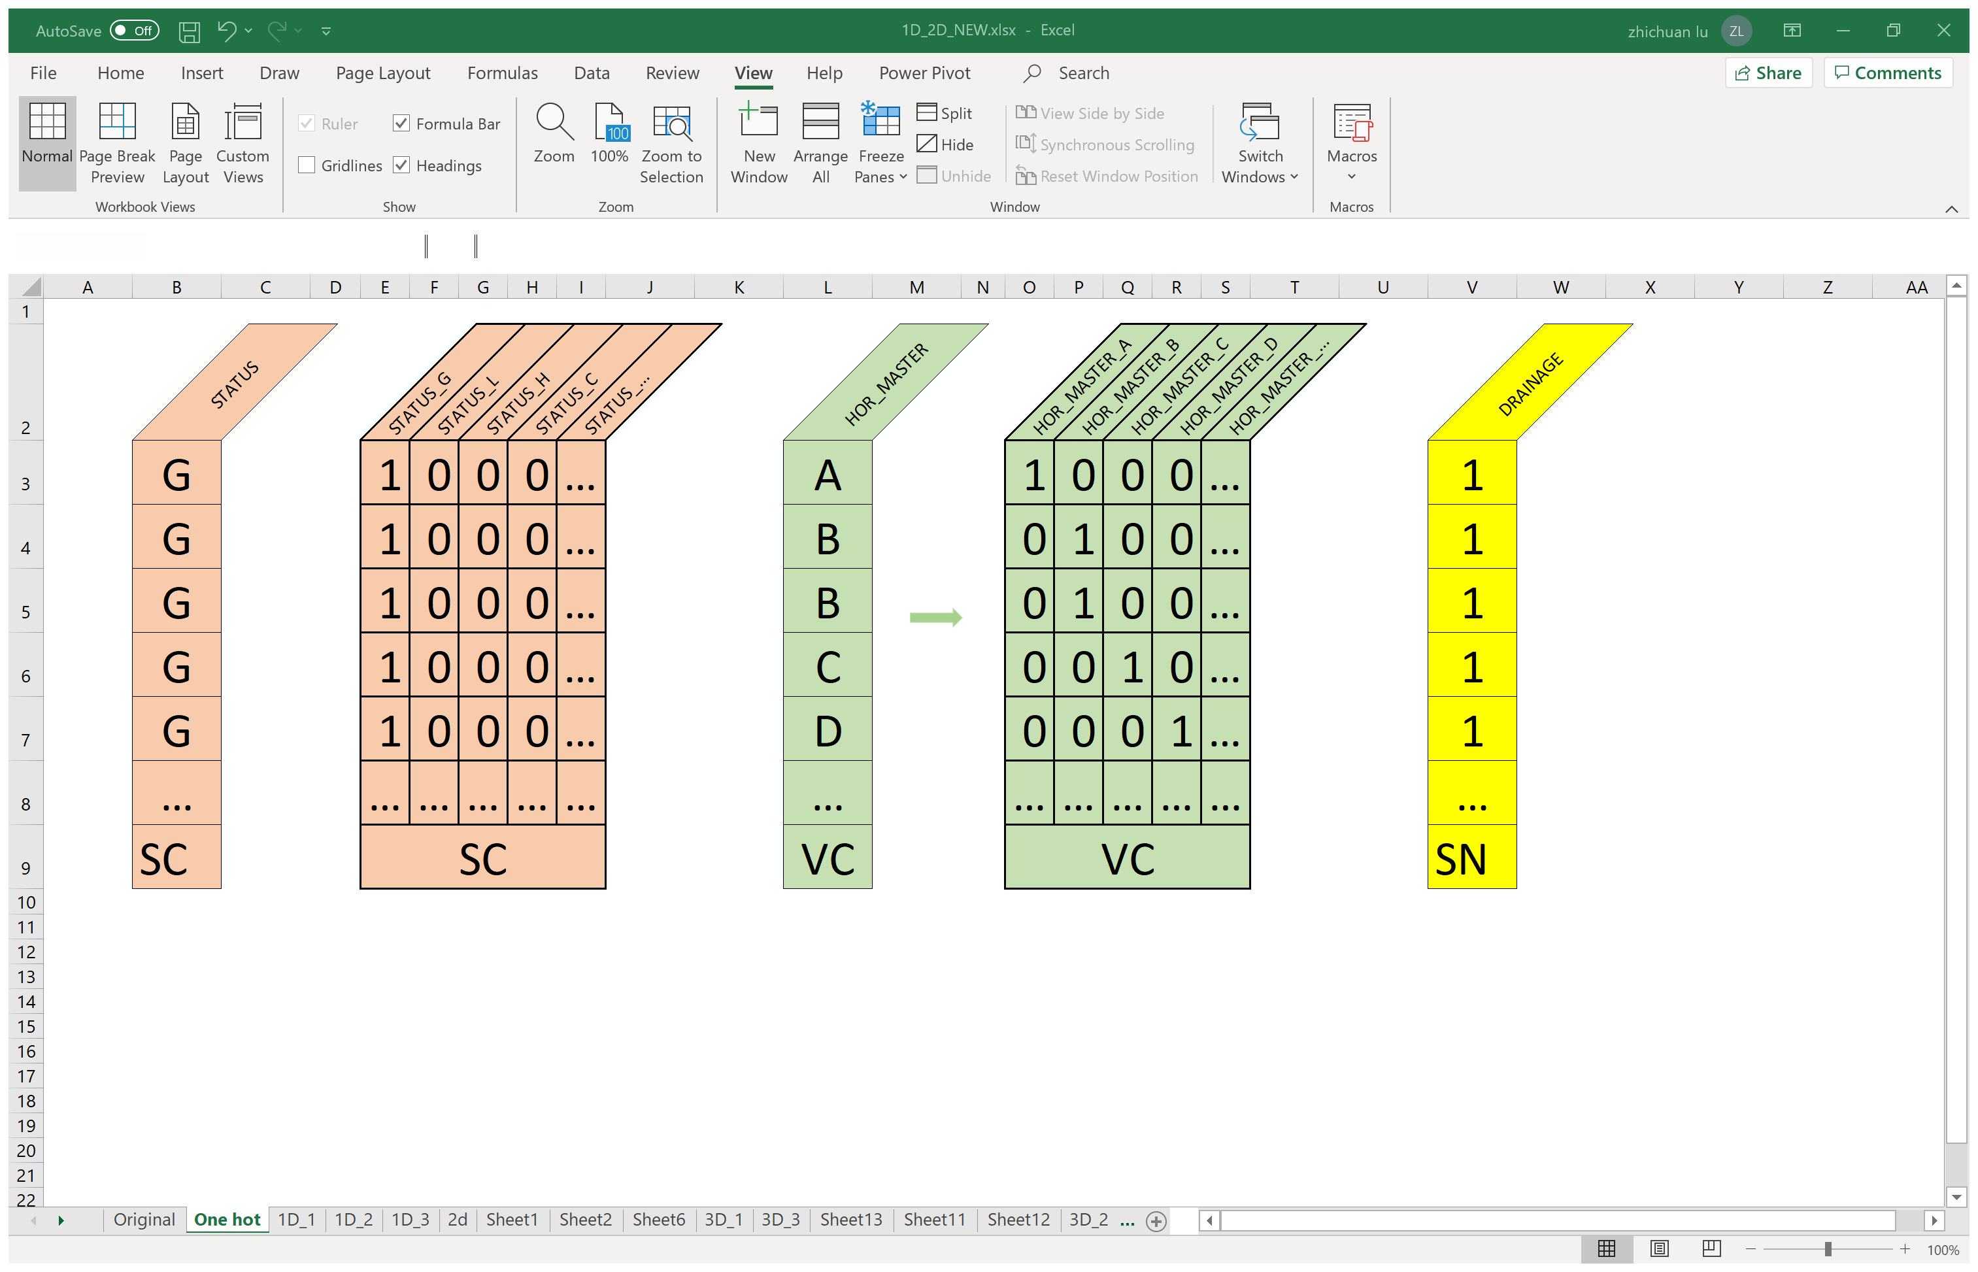
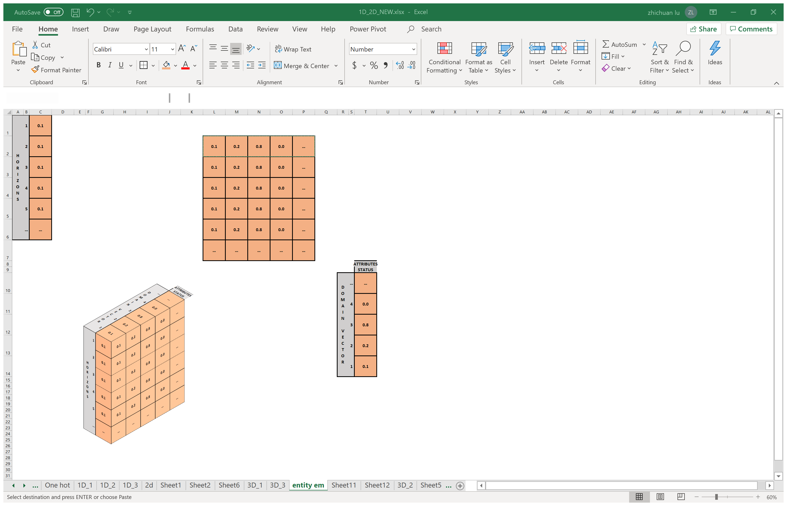
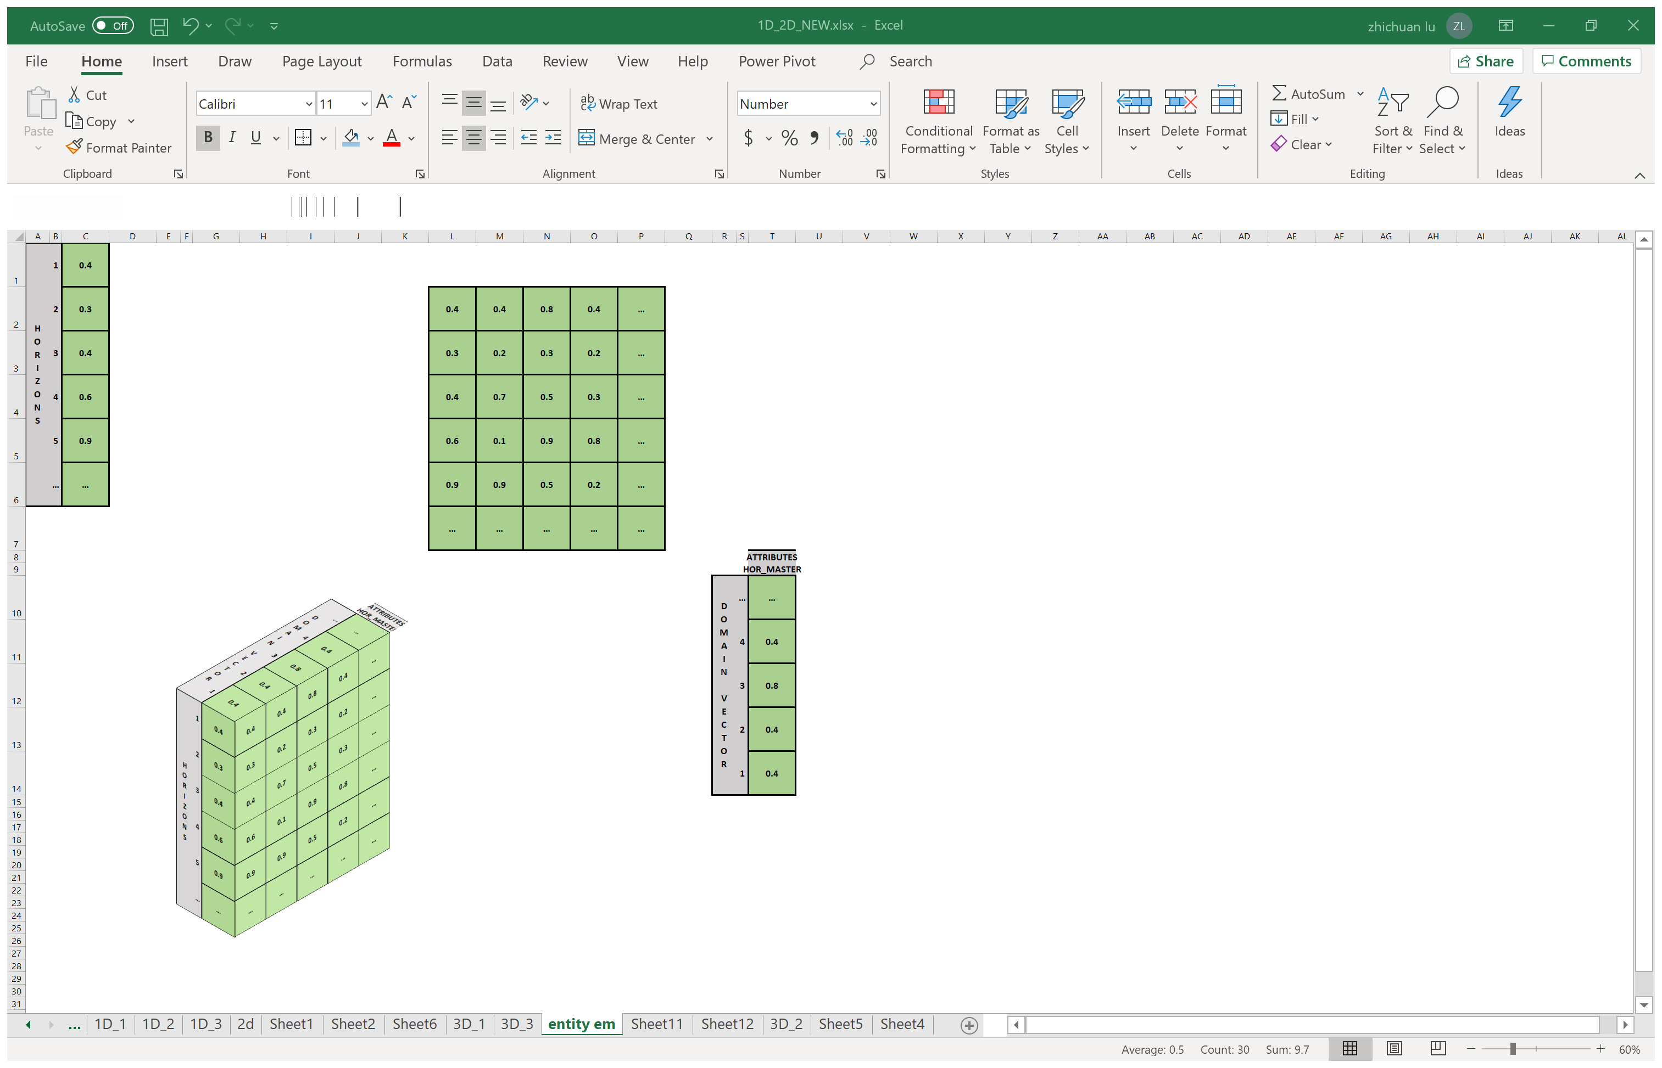
Objectives
Data Preparation
Data Transformations -- 3D Transformations
-- SALI Data
-- Feature Selection
Initial format of
a single point SALI data
Entity Embedding
-- Data Preprocessing
Notes:
In addition, in entity embedding, if all attributes including not just categorical attributes, but also numeric attributes, are embedded into same length of vectors,

Slide 23
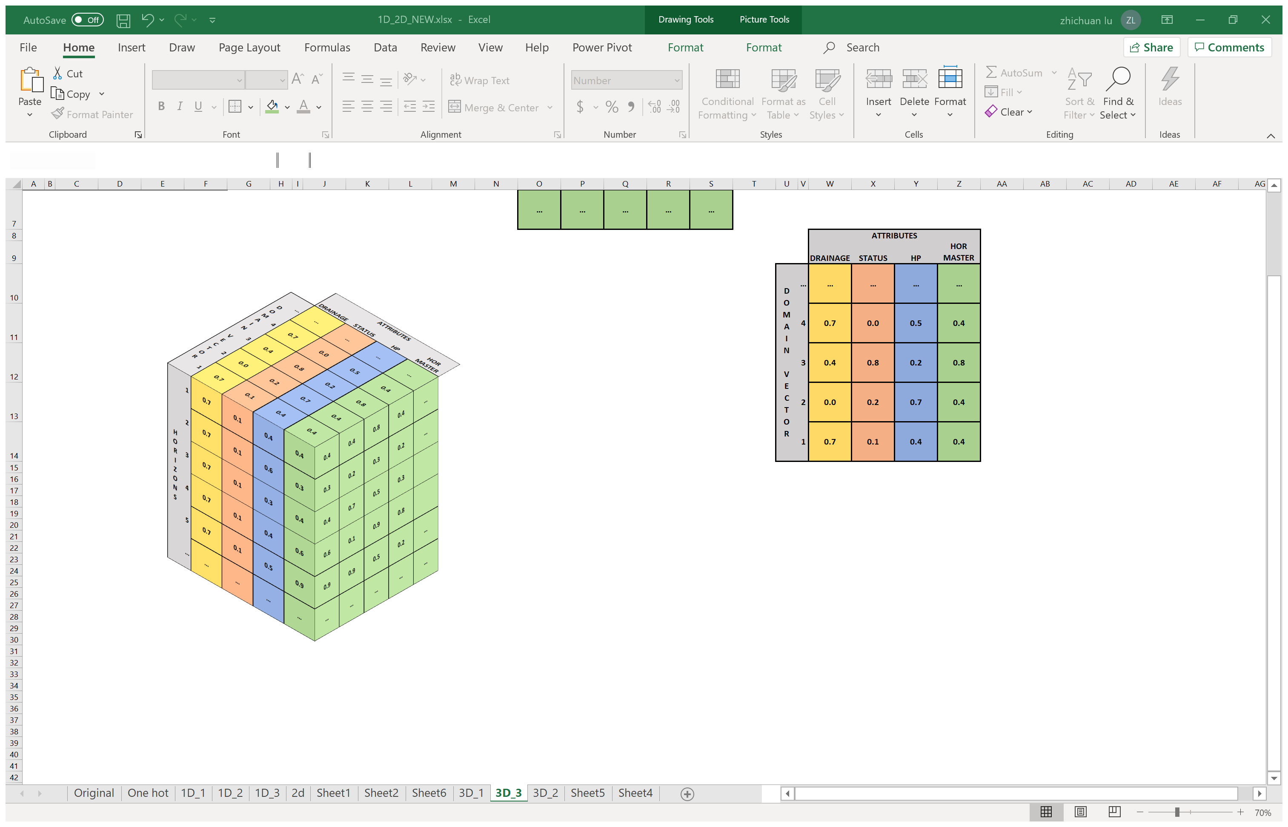
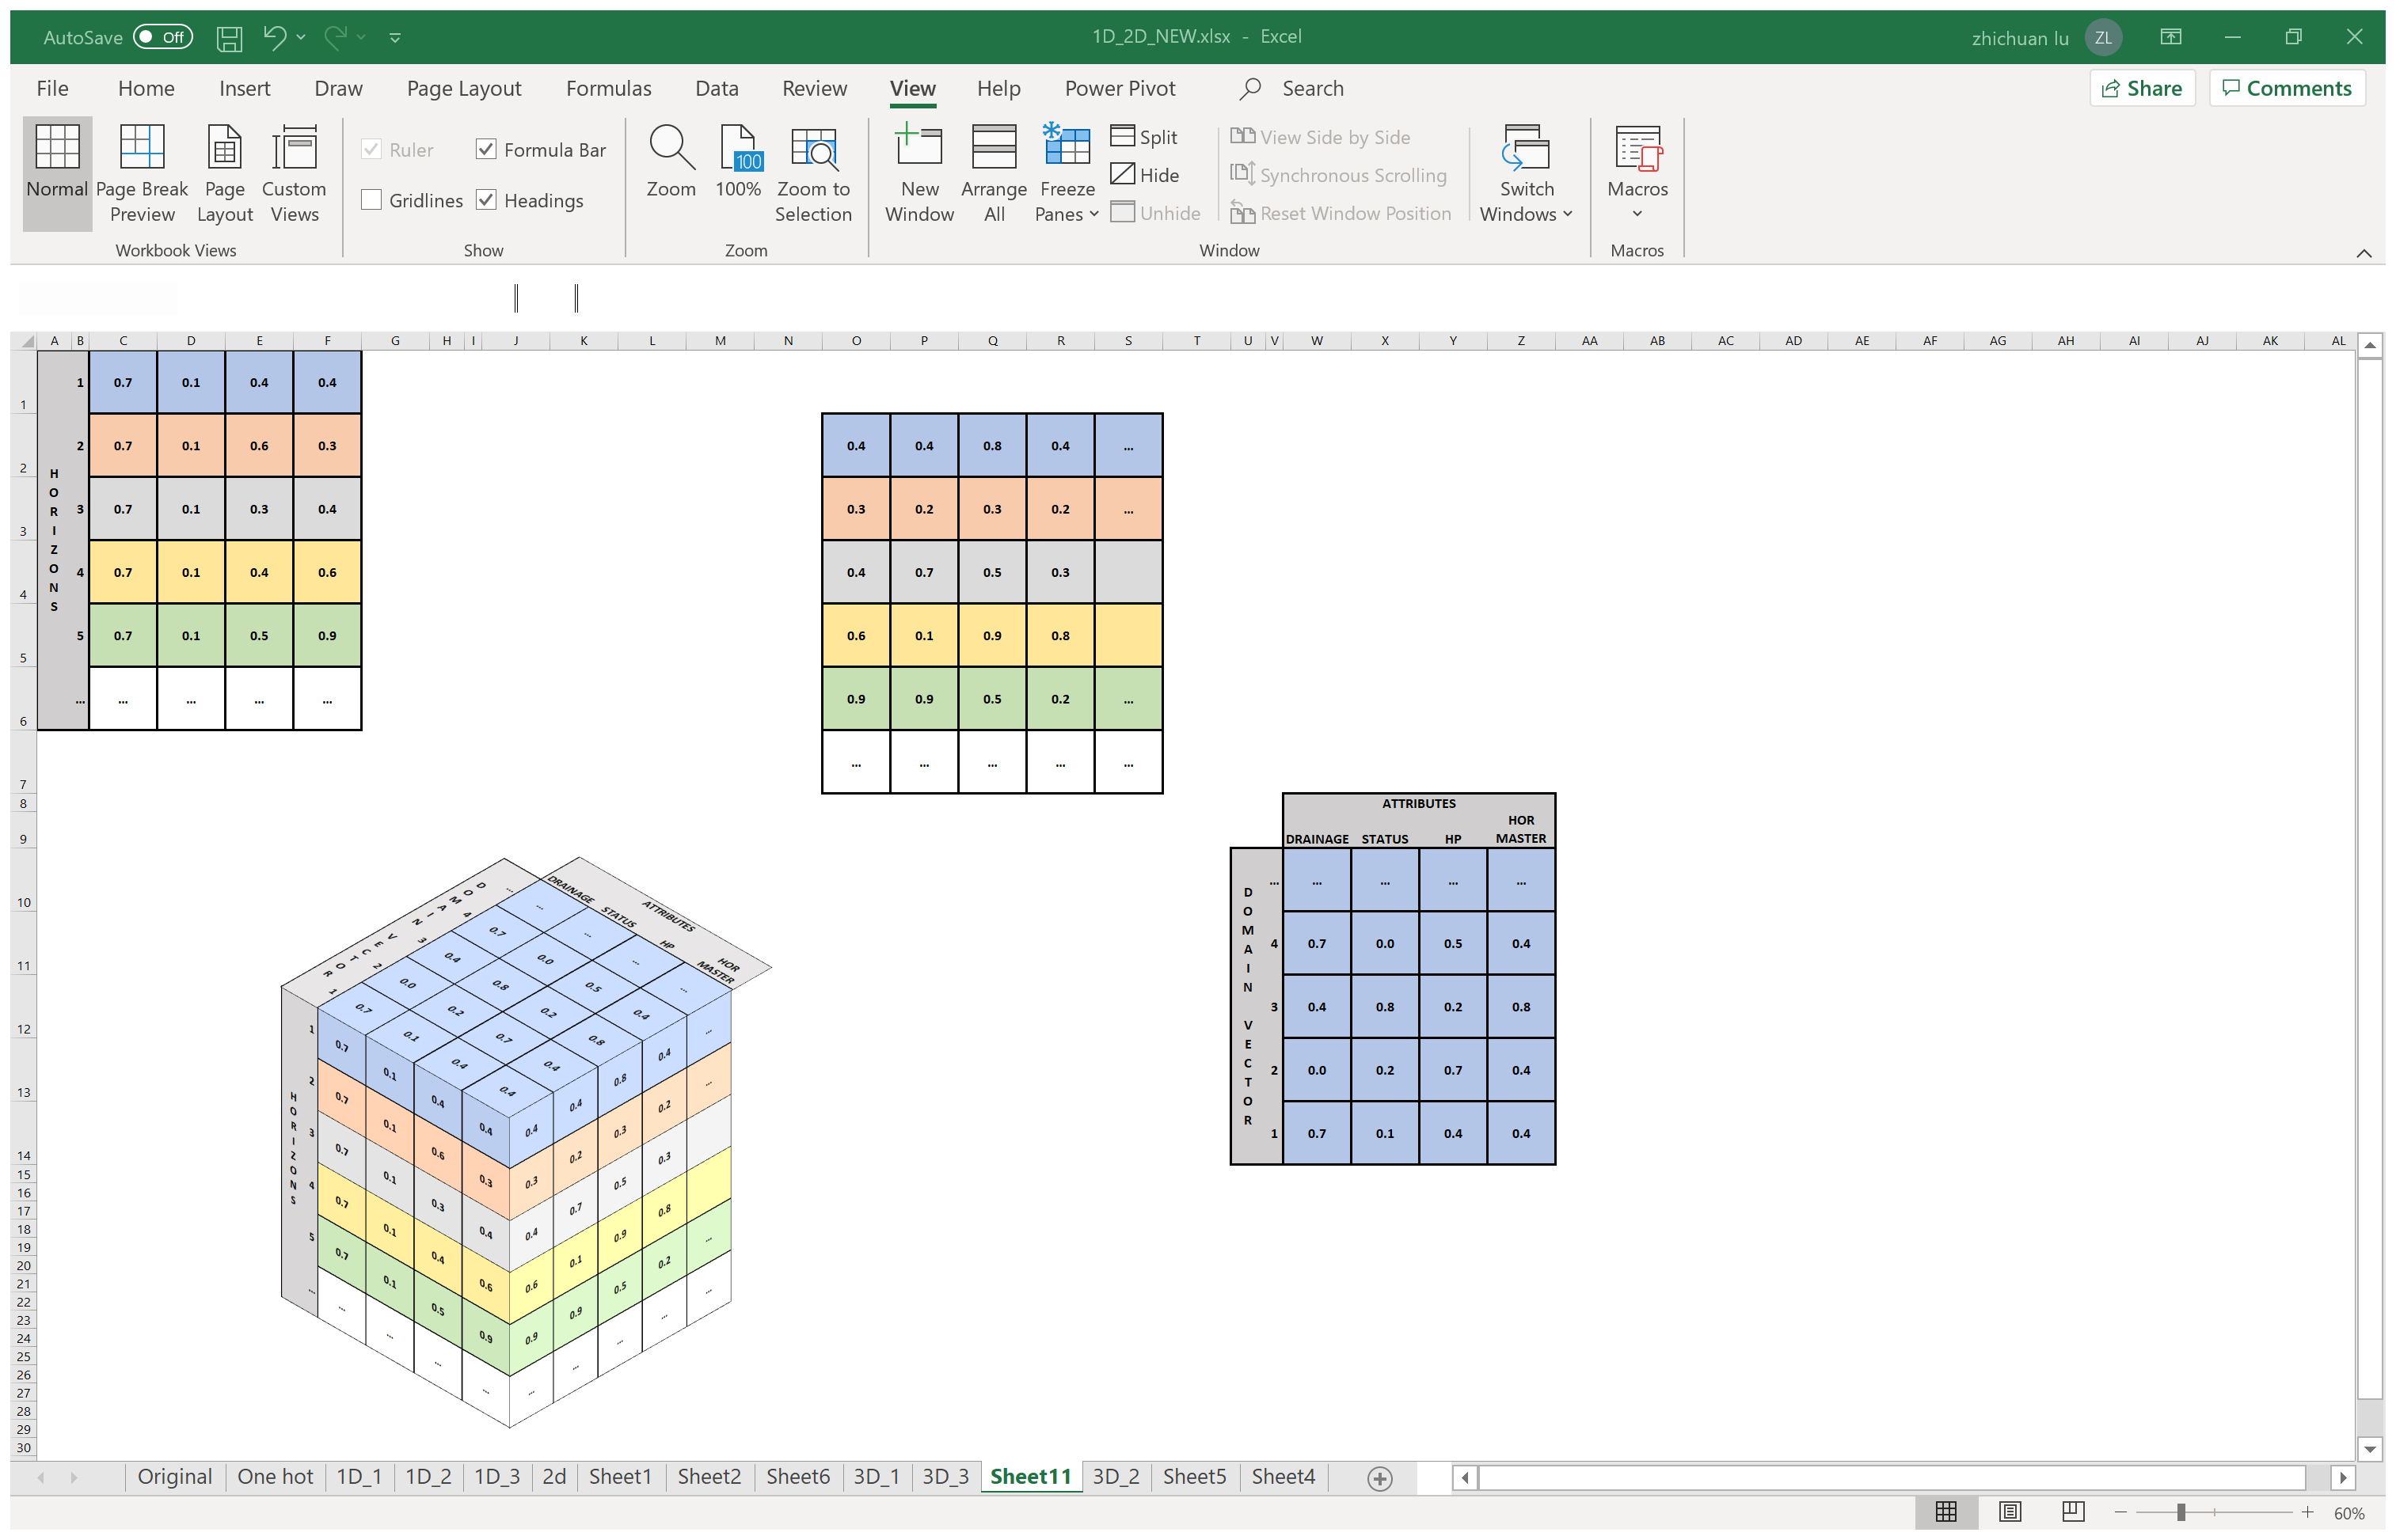
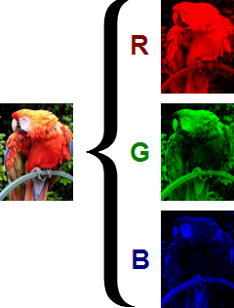
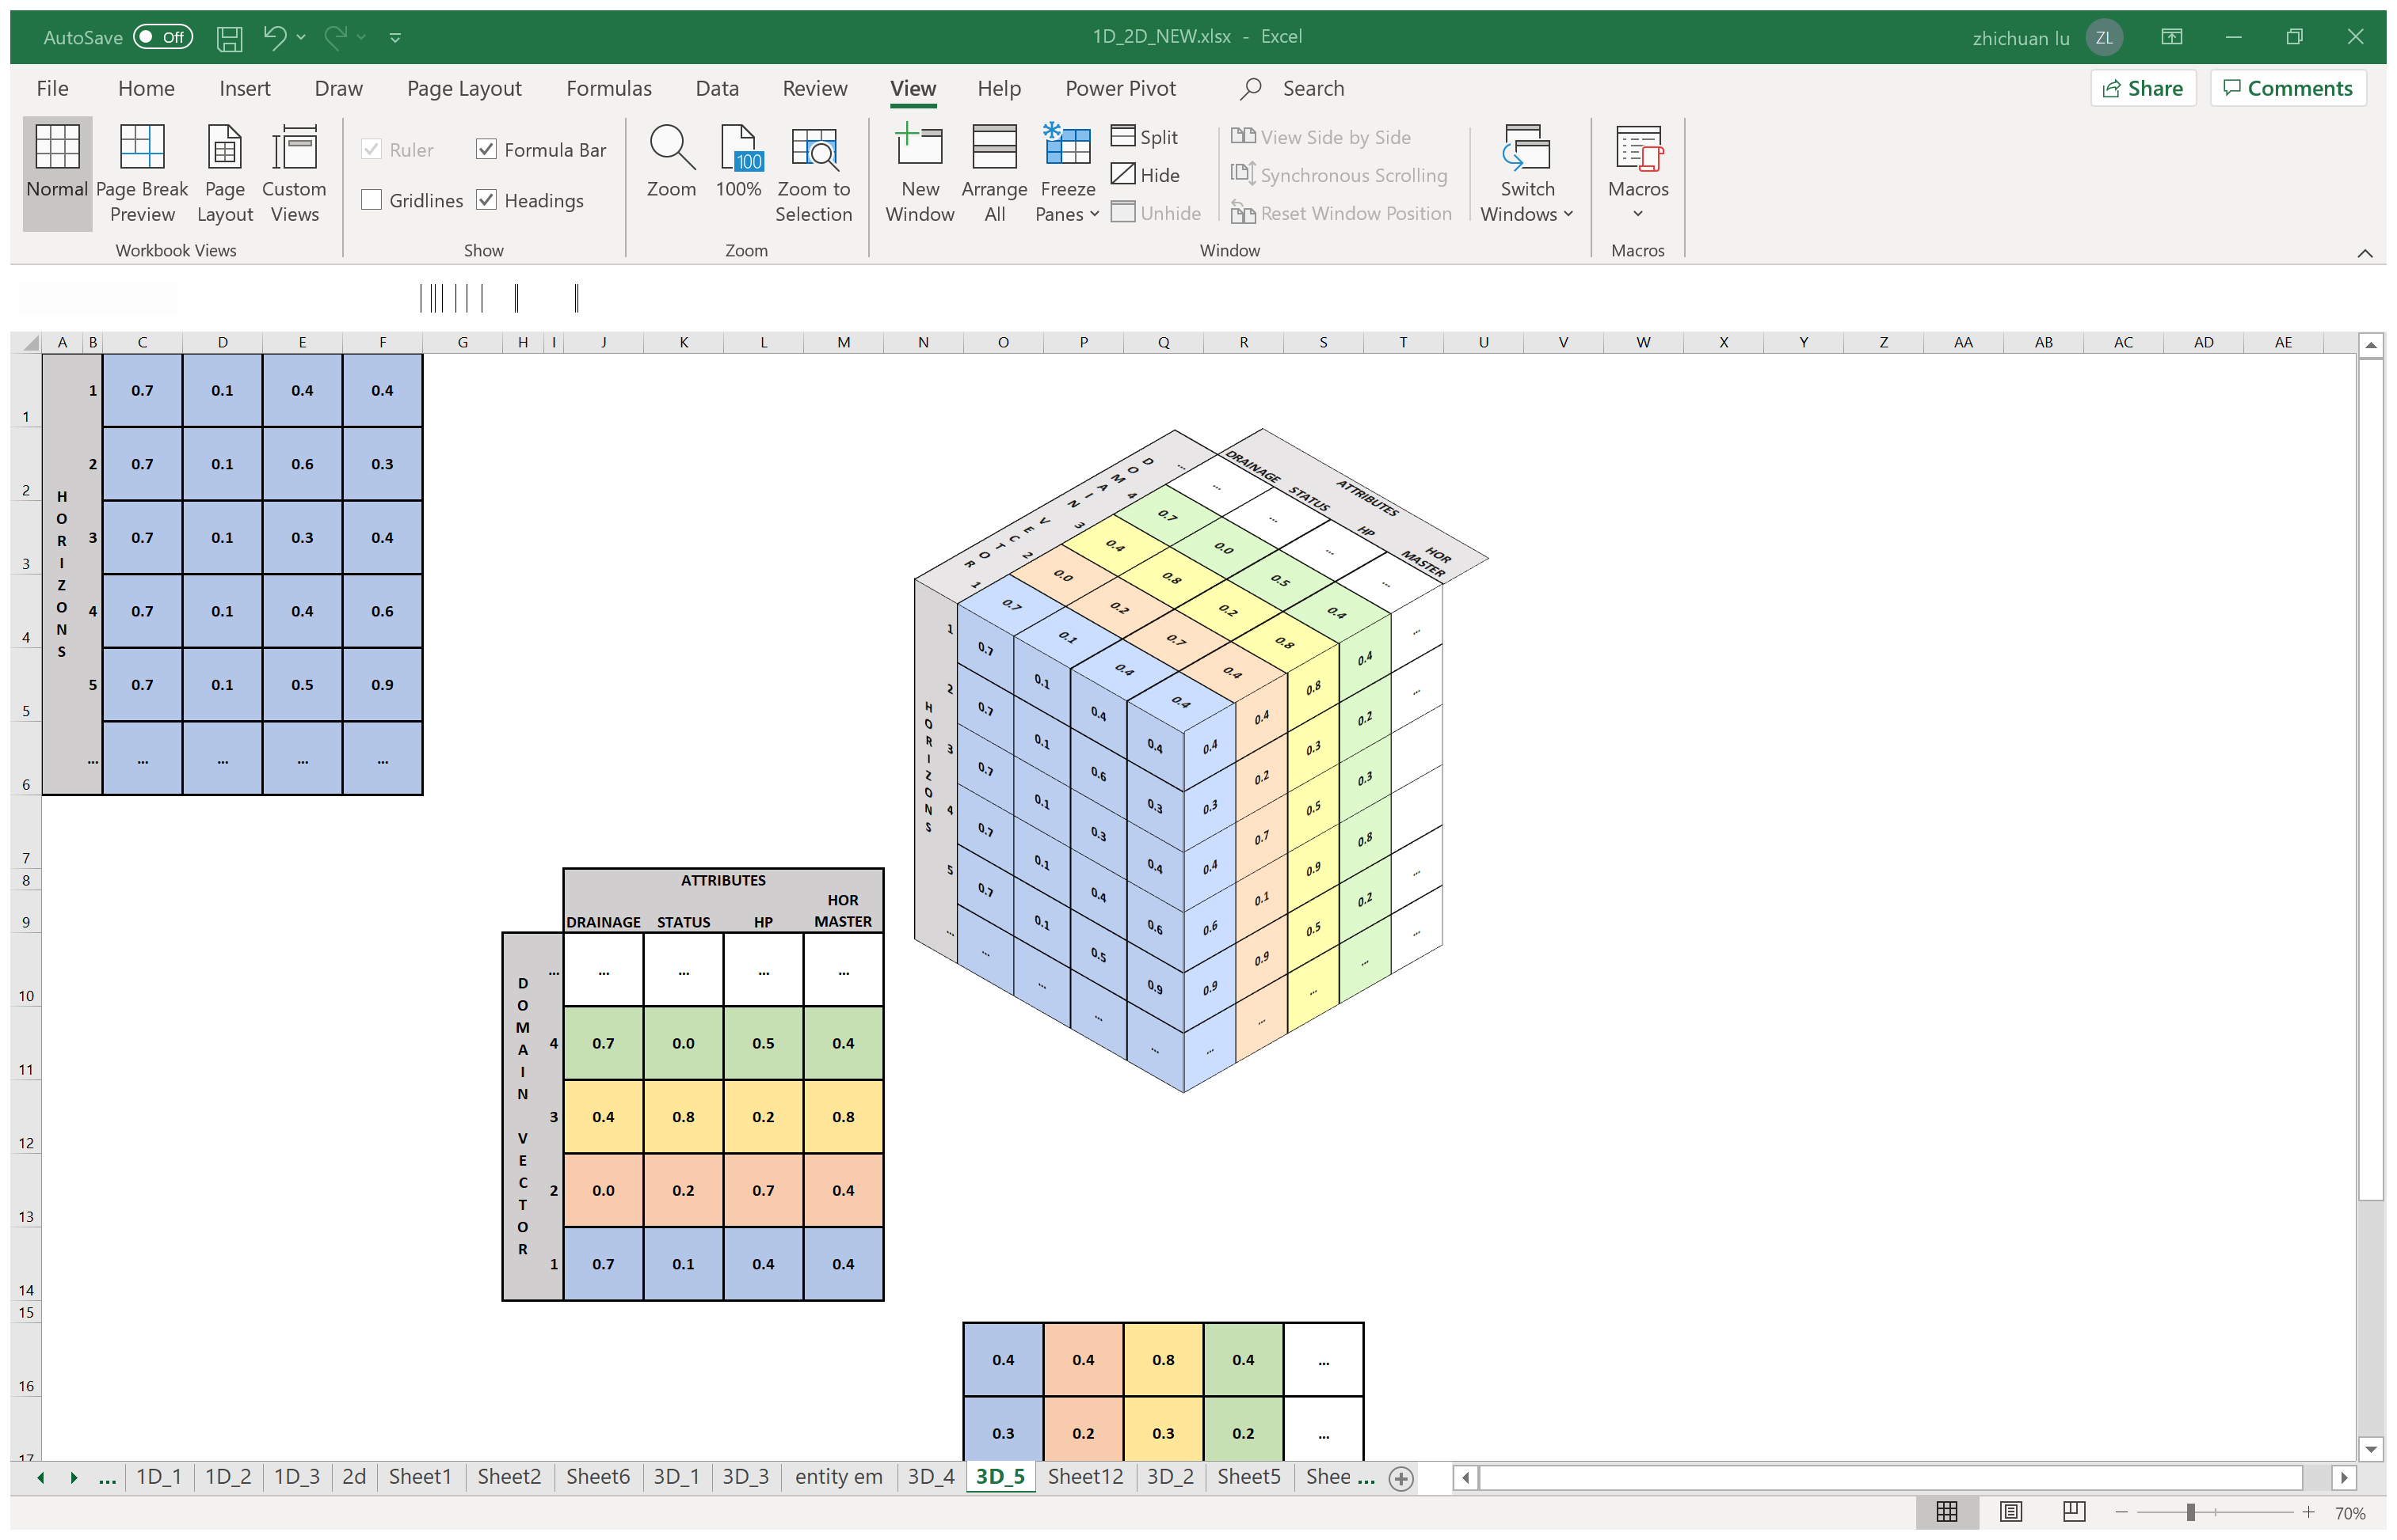
Objectives
Data Preparation
Data Transformations -- 3D Transformations
-- SALI Data
-- Feature Selection
Initial format of
a single point SALI data
Entity Embedding
3D transformation
?
-- Data Preprocessing
√
?
Notes:
Then it will produce a 2D - 3D transformation.
The benefit of this kind of transformation is such that each attribute is presented in equal space.
This 3D data is like a colorful image with R, G and B multiple layers of 2D shapes.
With a proper slicing direction, this 3D cube can be fed into the neural network model as a sequence of 2D inputs.

Slide 24
Data Preprocessing
Objectives
Data Preparation
-- SALI Data
-- Feature Selection
-- Data Preprocessing
2. Missing Data
Notes:
The second matter I would like to discuss in data preprocessing is the treatment of missing data.

Slide 25
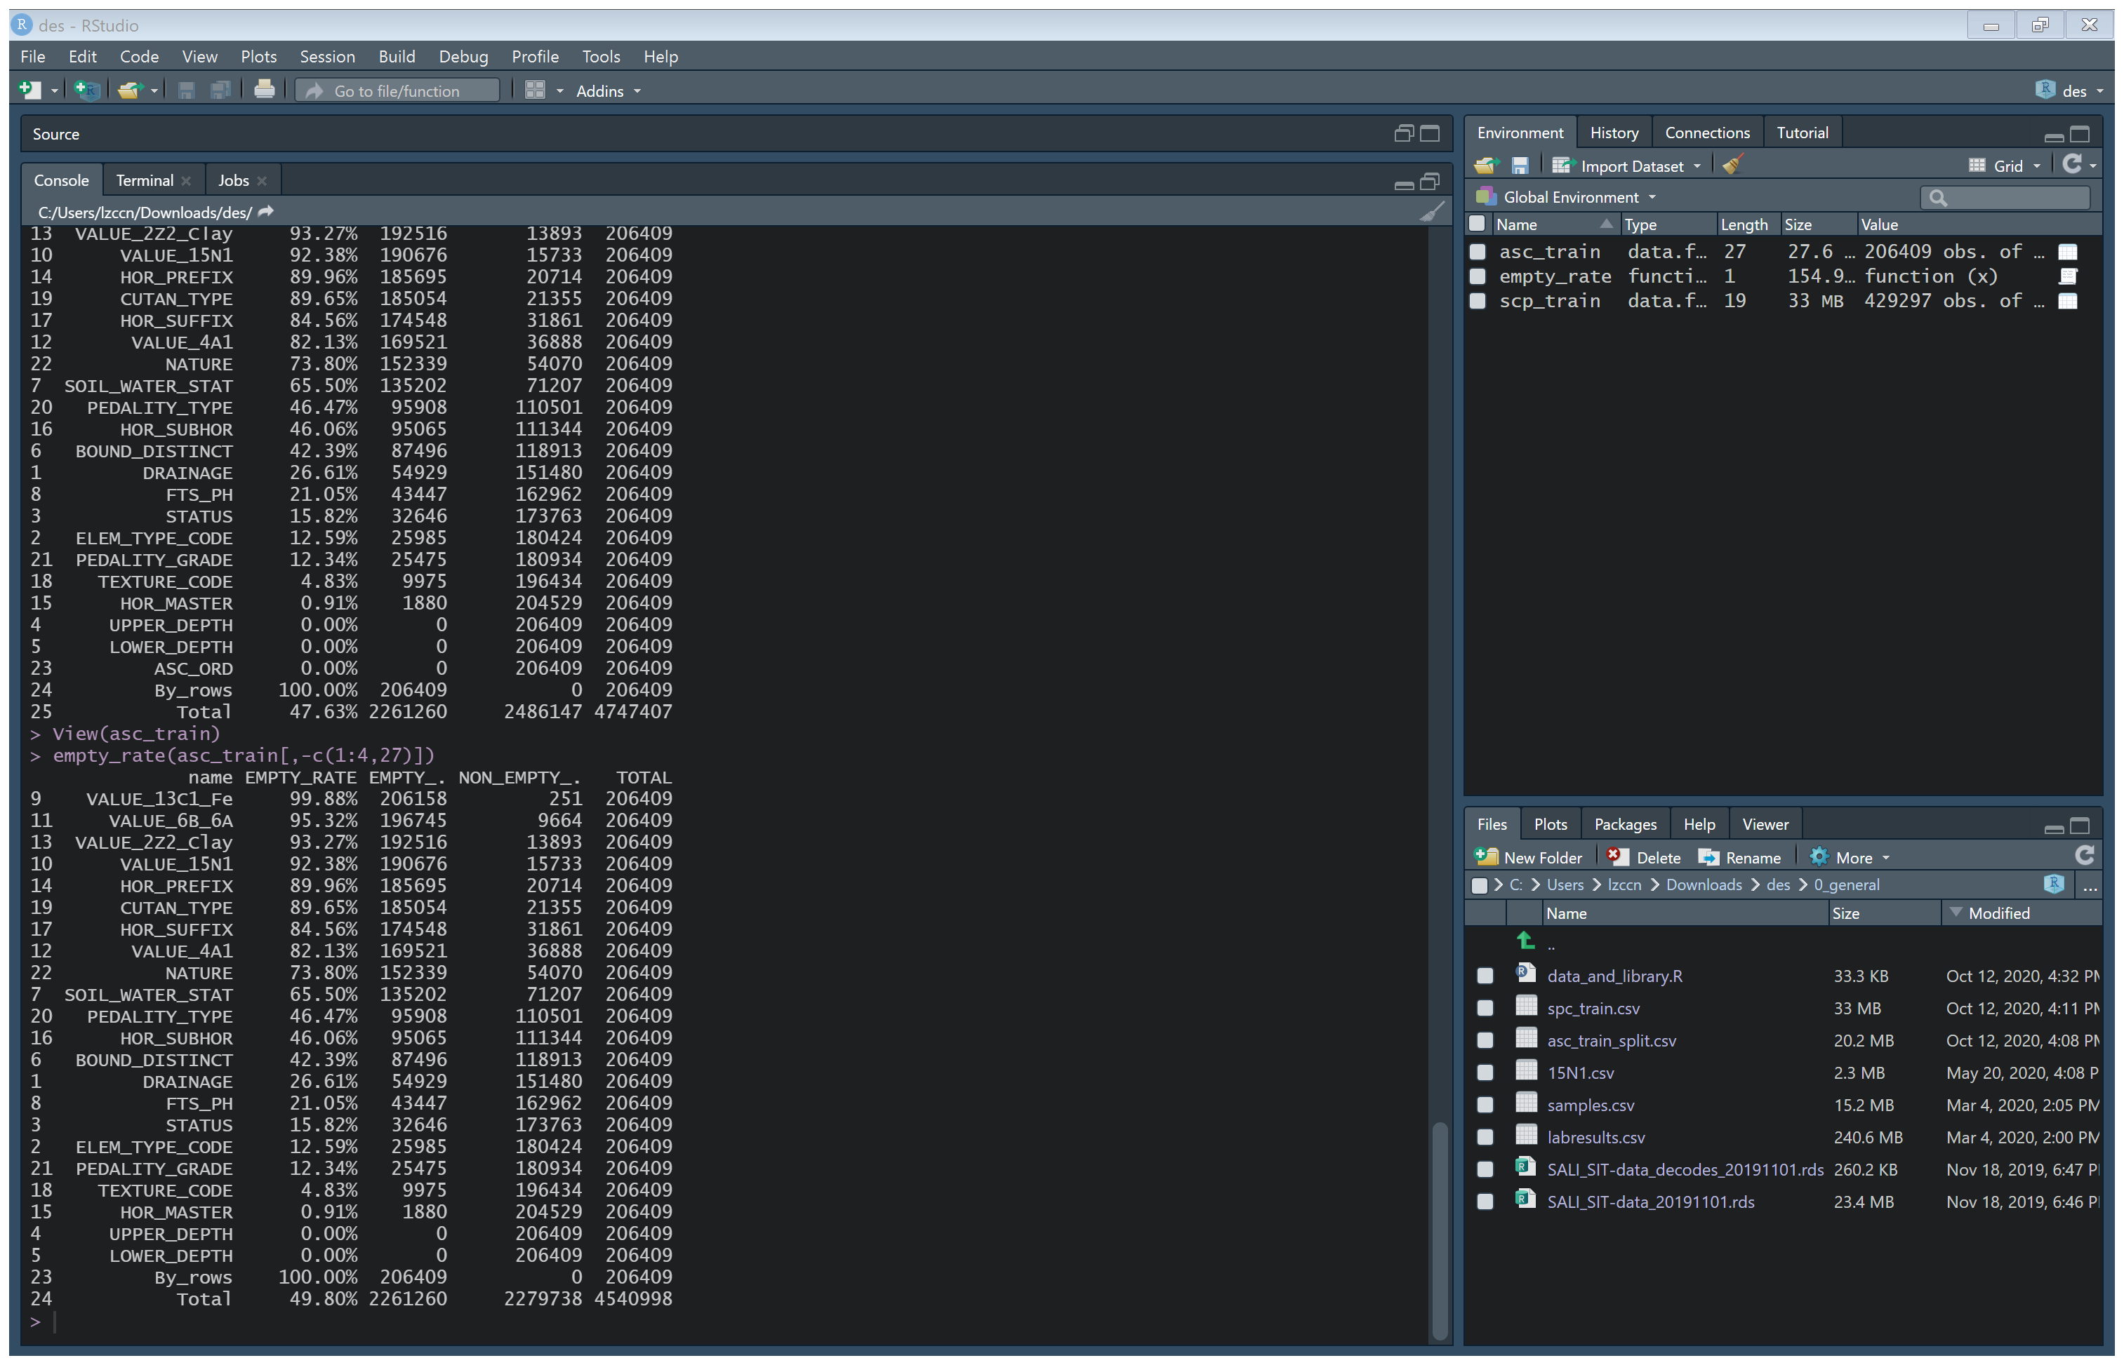
Missing Data
Objectives
Data Preparation
-- SALI Data
--High missing data rate: ~50%
Removing the data with missing values is not applicable
-- Feature Selection
-- Data Preprocessing
Notes:
The total missing value rate in the SALI data is around 50%, based on selected attributes.
So, the common process of removing the data with missing values is not suitable in this project.

Slide 26
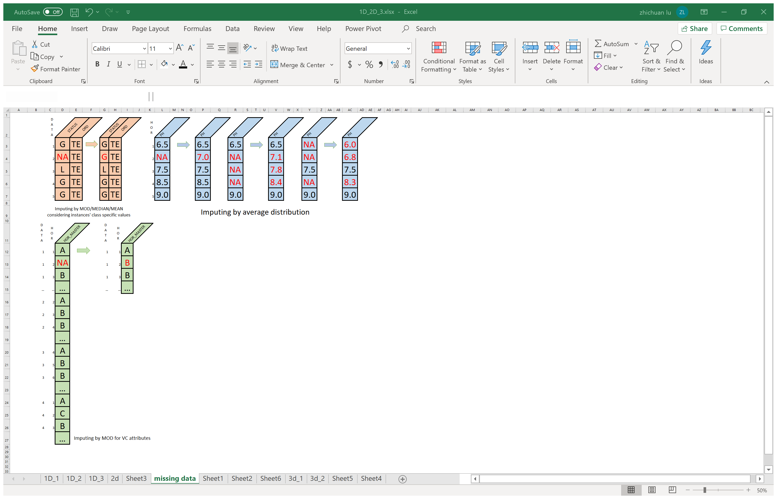
Missing Data
Objectives
Data Preparation
-- SALI Data
Imputation does not necessarily give better results
-- Feature Selection
-- Data Preprocessing
Notes:
Another method is to impute the missing values; however, Imputation does not necessarily give better results.

Slide 27
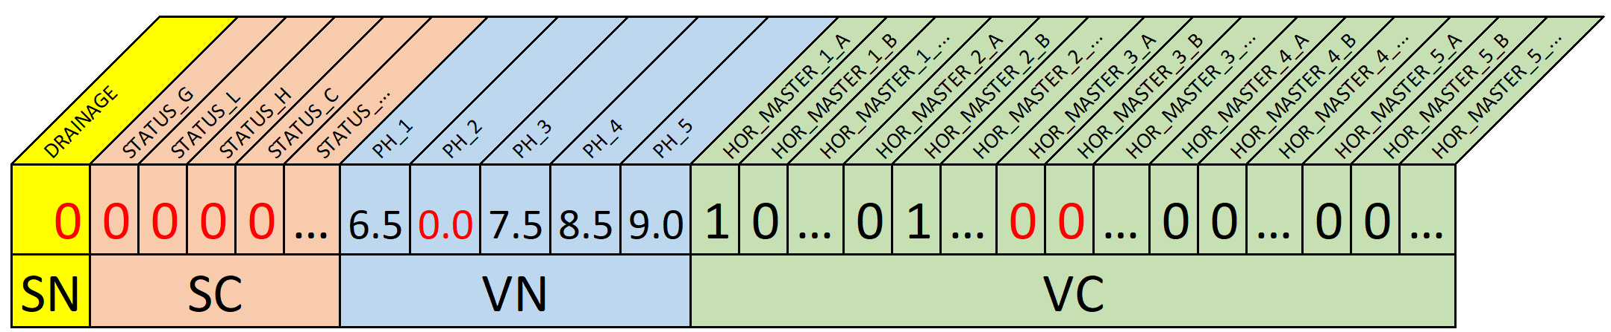
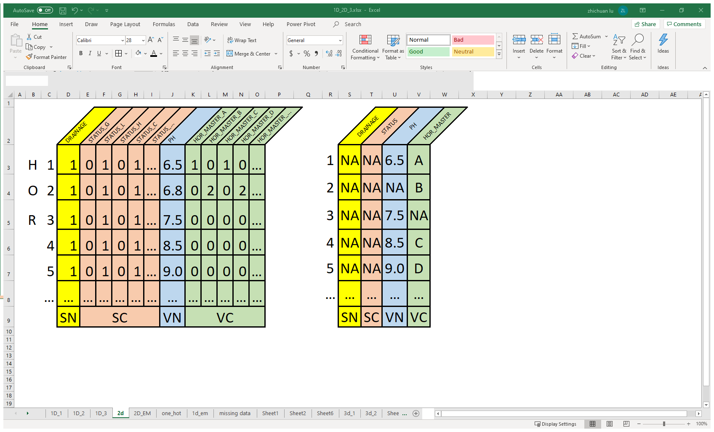
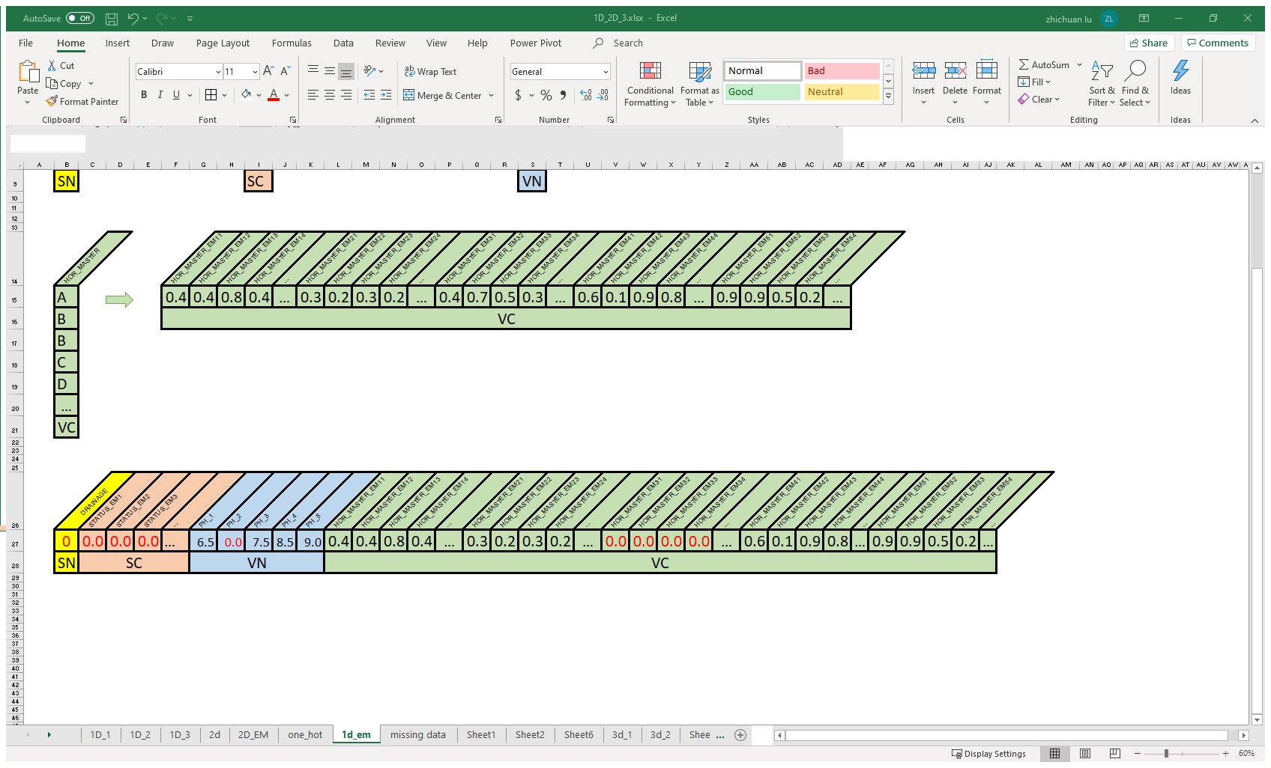
Missing Data
Objectives
Data Preparation
-- SALI Data
--General consideration : If experts can, machine learning should be able to as well.
--Processing:
Data with some missing values are not deleted.
Treat them as missing (NA), if the algorithm allows.
Otherwise replace with 0 .
-- Feature Selection
-- Data Preprocessing
Initial format of
a single point SALI data
1D Data
1D – One Hot Encoding
1D – Entity Embedding
Notes:
In this project, The basic idea in treating missing data is : If soil experts can classify a data with its missing values, machine learning should be able to achieve the same results as well.
So, the processing is: data with missing values will not be removed and will be replaced with a zero value in neural network models.
These pictures show how missing data will be treated in 1d,

Slide 28
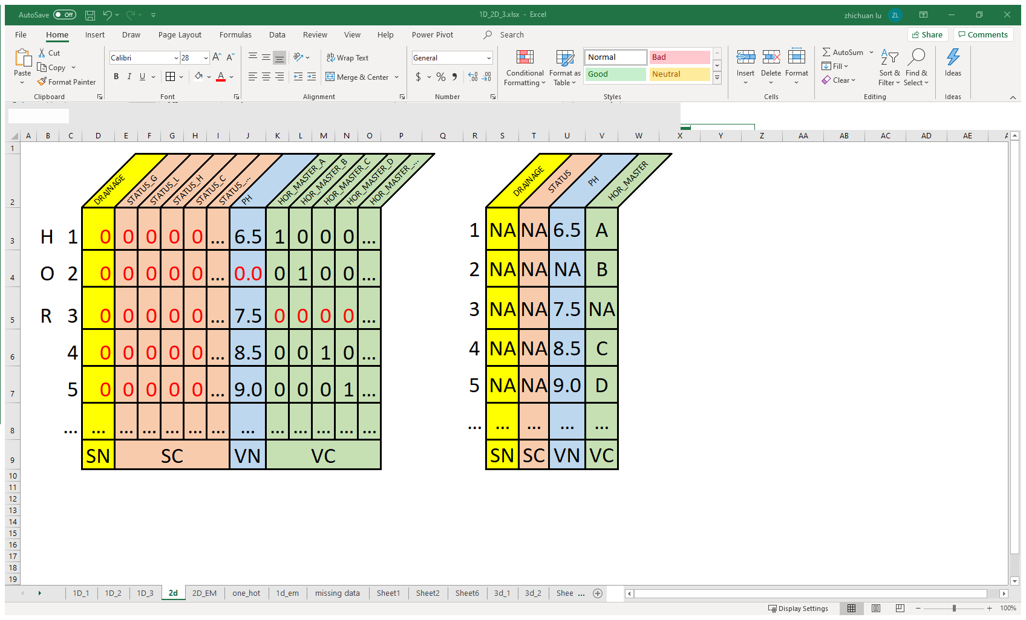
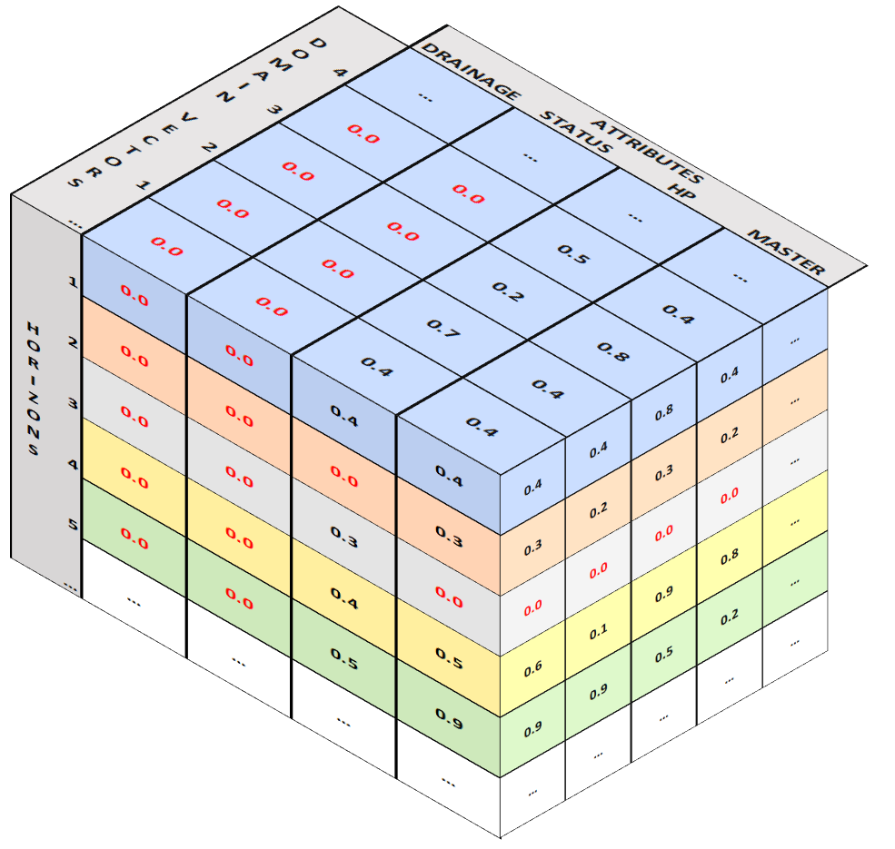
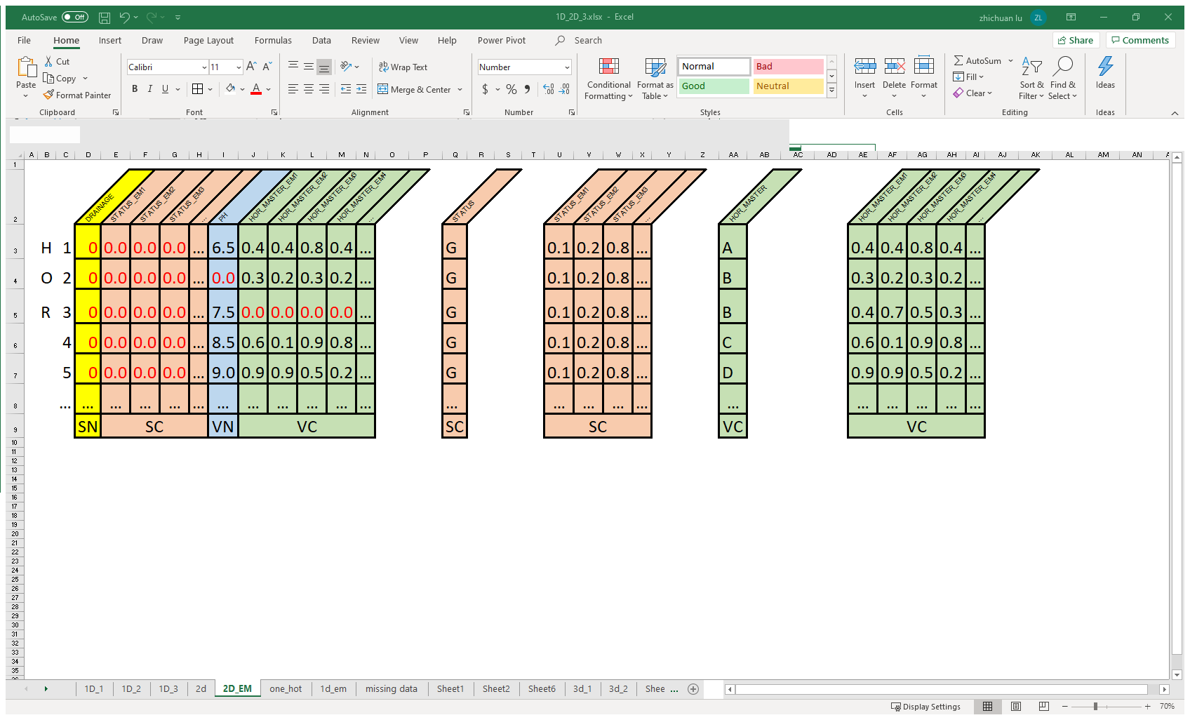
Missing Data
Objectives
Data Preparation
2D Data
3D Data
-- SALI Data
-- Feature Selection
Initial format of
a single point SALI data
-- Data Preprocessing
2D – One Hot Encoding
2D – Entity Embedding
3D – Entity Embedding
Notes:
These pictures show how missing data are treated in 1d, 2d, and 3d data format.

Slide 29
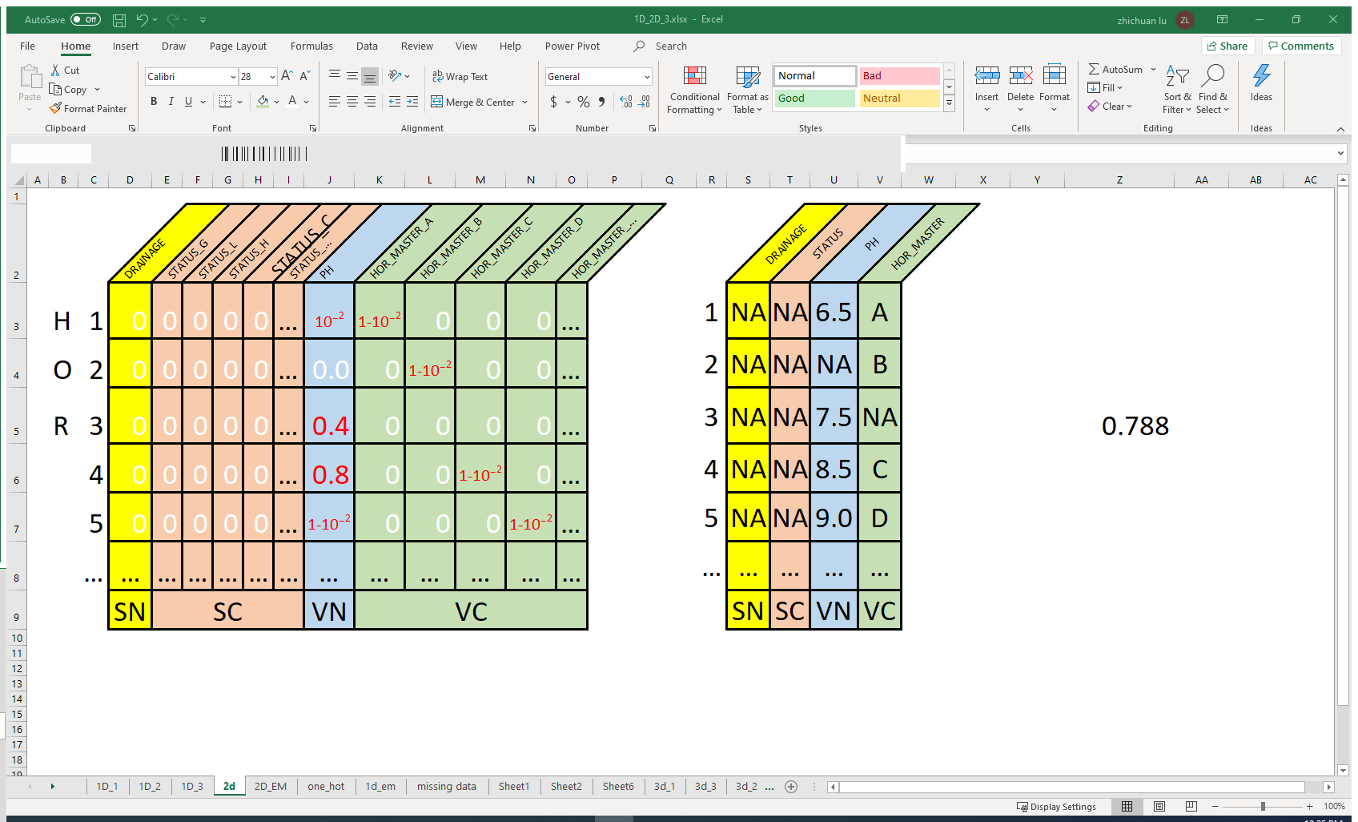












Missing Data
Objectives
Data Preparation
-- SALI Data
$$x_{min}$$
$x_{1}$
$$x_{2}$$
$$x_{3}$$
$$x_{max}$$
-- Feature Selection
Adjusted MinMax data normalization:
-- Data Preprocessing
$$x^{′}=ε+(1−2ε)\frac{x −x_{min}}{x_{max}−x_{min}}, { x}^{′}∈\left[ε, 1−ε\right]$$
0
$$ε$$
$x_{1}^{′}$
$x_{2}^{′}$
$$x_{3}^{′}$$
$$1−ε$$
$$ε={10}^{−2}$$
Notes:
In order to dedicate the zero value only to the missing data, an adjusted minmax normalization is applied to the data to rescale attribute’s domain values in a range of 0 – 1 but excluding 0.

Slide 30
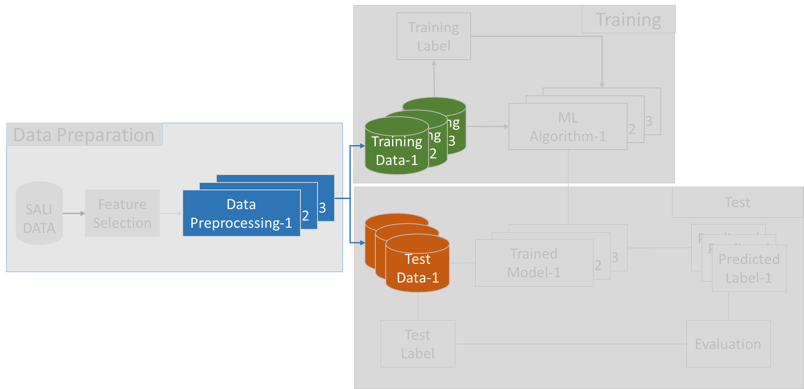
Data Preprocessing
Objectives
Data Preparation
-- SALI Data
-- Feature Selection
-- Data Preprocessing
Notes:
After proper preprocessing, we get the data ready to feed into the model.
Training and test data will be completely separated.

Slide 31
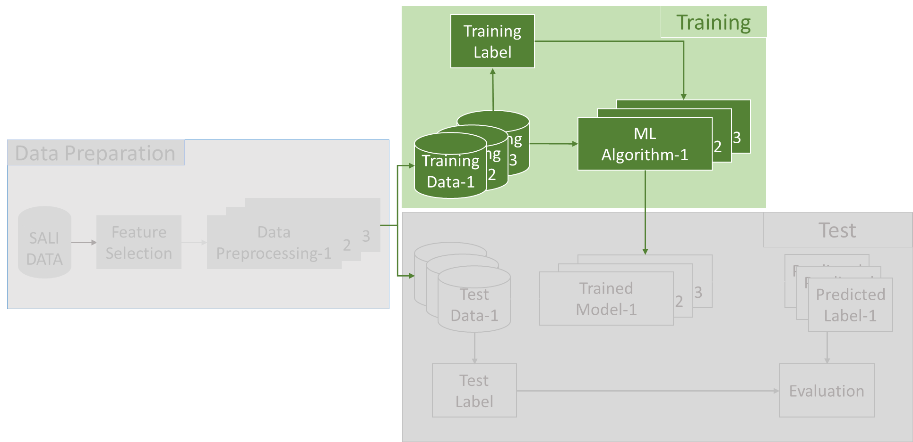
ASC- Model Training
Objectives
Data Preparation
-- SALI Data
-- Feature Selection
-- Data Preprocessing
ASC-
Model Training
Notes:
we will start the model training. Let’s start with the ASC model training.

Slide 32
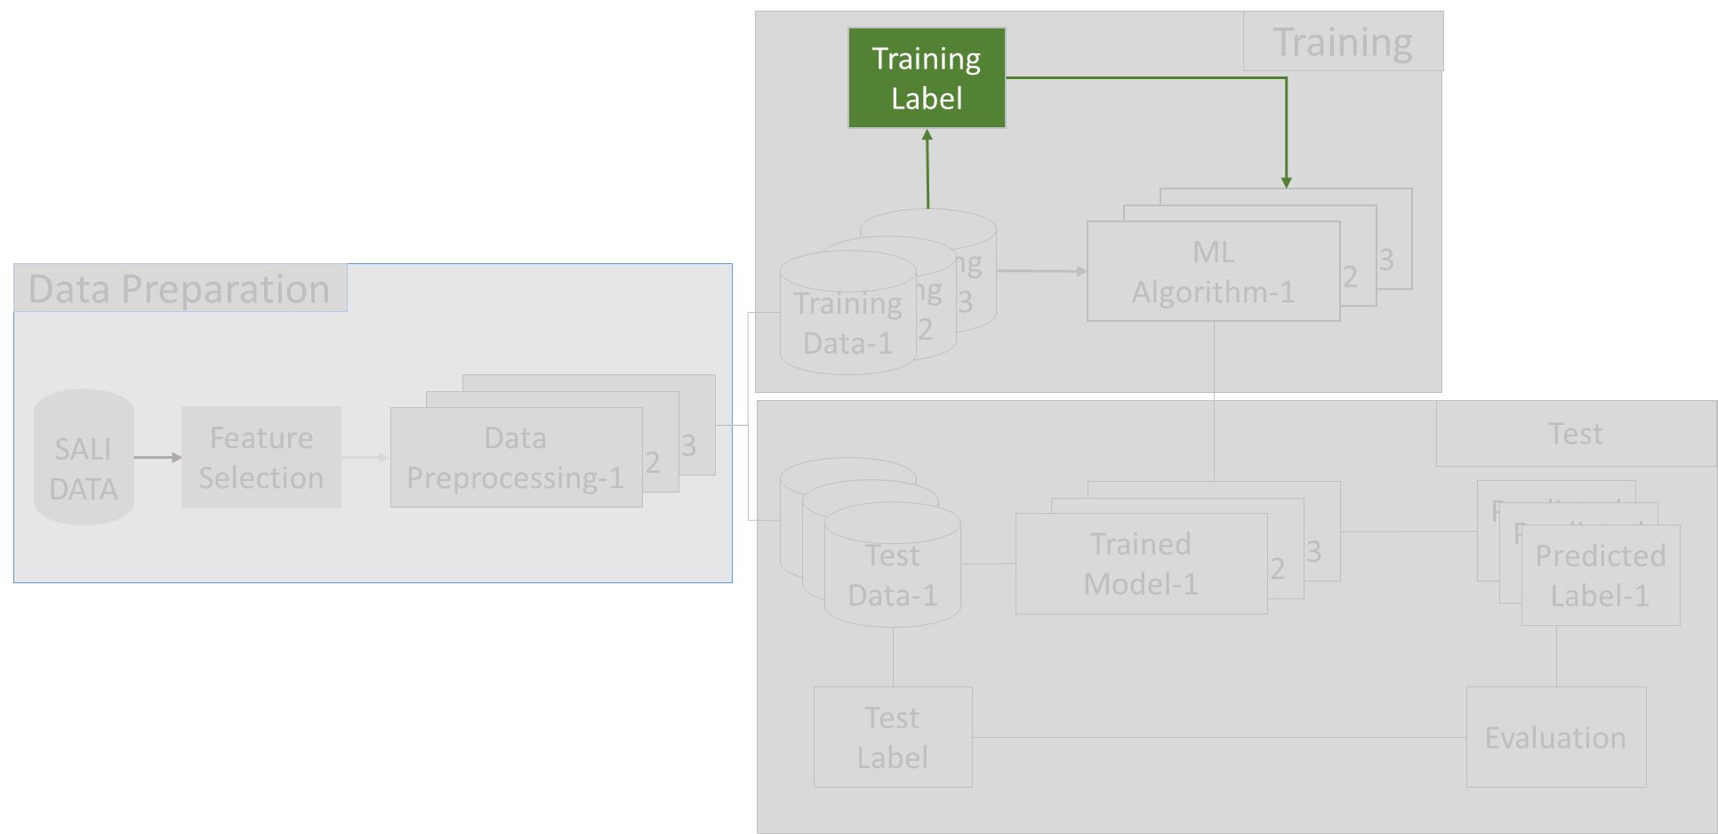
ASC- Model Training
Objectives
Data Preparation
-- SALI Data
-- Feature Selection
-- Data Preprocessing
ASC-
Model Training
Notes:
Foremost , I would like to talk about ASC’s output labels.

Slide 33
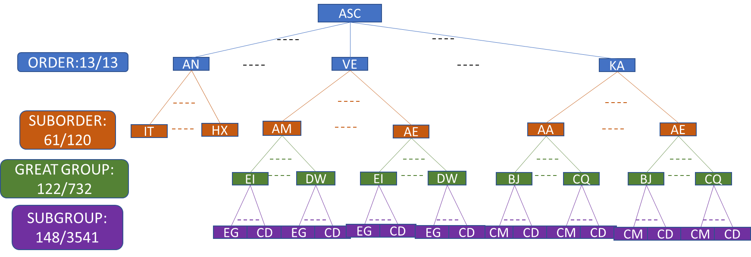
Hierarchical Classifications
Objectives
Data Preparation
-- SALI Data
-- Feature Selection
-- Data Preprocessing
ASC-
Model Training
--Hierarchical
Classifications
Notes:
The Australian Soil Classification, ASC, is a four layer hierarchical classification structures. This format brings with it some challenges..

Slide 34


Hierarchical Classifications
Objectives
Data Preparation
-- SALI Data
-- Rare categories
More than 80% of leaf nodes have less than 10 samples
-- Feature Selection
-- Data Preprocessing
ASC-
Model Training
--Hierarchical
Classifications
-- Inconsistency
A subclass is predicted that is not an optional subclass of its predicted parent class
-- Error Propagation
Parent class errors are propagated down the hierarchy
Notes:
Firstly, the Rare categories problem. There are too many leaf nodes at the end of the hierarchy and most of them don’t have enough samples to train on.
Secondly, Inconsistent predictions between parent and child classifications.
And thirdly, errors will accumulate all the way down the hierarchy.
It is important to find ways to avoid these problems or minimize their negative effects during the model design phase.

Slide 35

Objectives
ASC- Model Training
Data Preparation
-- SALI Data
-- Feature Selection
-- Data Preprocessing
ASC-
Model Training
--Hierarchical
Classifications
Notes:
With these questions, let’s have a look at the neural network models and the architecture design.

Slide 36
Objectives
ASC- Model Training
Data Preparation
-- SALI Data
-- Feature Selection
-- Data Preprocessing
 |  | Inputs
 |  | 1D Inputs |  | 2D Inputs |  | 2D+ Inputs
 |  | OneHot | EM | OneHot | Em | Em
Outputs | Multi-classes | MLP-Onehot-Multi | MLP-EM-Multi | DLNN-OneHot-Multi | DLNN-EM-2D-Multi | DLNN-EM-2D+-Multi
 | Binary-classes | MLP-Onehot-Binary | MLP-EM-Binary | DLNN-OneHot-Binary | DLNN-EM-2D-Binary | DLNN-EM-2D+-Binary
ASC-
Model Training
--Hierarchical
Classifications
Notes:
Based on different types of inputs and outputs, different types of models can be created.

Slide 37

Objectives
Neural Network Models – Multi-Layer Perceptron (MLP)
Data Preparation
-- SALI Data
MLP-OneHot-1D-Multi-Classes Model
-- Feature Selection
-- Data Preprocessing
ASC-
Model Training
--Hierarchical
Classifications
--Models - MLP
Notes:
This diagram is a typical MLP multiclasses model that uses onehot encoding to generate 1d input data. Each line connected to two neurons is a weight value that is adjusted at each epoch of model training for better classification results.

Slide 38

Objectives
Neural Network Models – Multi-Layer Perceptron (MLP)
Data Preparation
-- SALI Data
MLP-OneHot-1D-Bianry-Classes Model
-- Feature Selection
-- Data Preprocessing
ASC-
Model Training
--Hierarchical
Classifications
--Models - MLP
Notes:
This model is similar to the first one but with binary outputs.

Slide 39
Objectives
Neural Network Models – Multi-Layer Perceptron (MLP)
Data Preparation
-- SALI Data
MLP-Embedding-1D-Multi-Classes Model
-- Feature Selection
Weights
1
Weights
-- Data Preprocessing
Weights
1
Weights
ASC-
Model Training
2
ORD_VE
0
0
--Hierarchical
Classifications
ORD_...
…
…
ORD_...
--Models - MLP
1
1
ORD_RU
1
Softmax
…
Relu
4
Relu
1D Input Layer
Embedding Layer
Hidden Layer
Hidden Layer
Multi-Outputs
Notes:
And the third one uses em to get the 1d input data, as mentioned before, the vector values of categorical attributes are calculated during the model fitting stage.

Slide 40
Objectives
Neural Network Models – Multi-Layer Perceptron (MLP)
Data Preparation
-- SALI Data
Bias
MLP-Embedding-1D-Binary-Classes Model
-- Feature Selection
Weights
Weights
Bias
Weights
-- Data Preprocessing
1
Bias
ASC-
Model Training
2
Weights
0
--Hierarchical
Classifications
…
ORD_RU
--Models - MLP
1
Sigmoid
1
…
Relu
4
Relu
1D Input Layer
Embedding Layer
Hidden Layer
Hidden Layer
Binary-Output
Notes:
And this is the binary output model for mlp em model.

Slide 41

Objectives
Neural Network Models – Deep Learning (DLNN)
Data Preparation
-- SALI Data
DLNN-OneHot-2D Model
-- Feature Selection
-- Data Preprocessing
ASC-
Model Training
--Hierarchical
Classifications
--Models - DLNN
Notes:
2d input models use matrix as weight’s values to train model, and the convolutional layer will generally be summarised by a max pooling layer , and then end up with similar structure of mlp model to generate the output. As the same, the output can be binary of multi classes.
The Benefit of 2d model is, it will have a better catching of the pattern between the attributes and horizons

Slide 42
Objectives
Neural Network Models – Deep Learning (DLNN)
Data Preparation
-- SALI Data
DLNN-Embedding-2D Model
-- Feature Selection
-- Data Preprocessing
EmbeddingWeights
ASC-
Model Training
--Hierarchical
Classifications
--Models - DLNN
2D Input
Layer
Embedding Layer
Convolution Layer
Pooling Layer
……
Dense
Layer
……
Binary/Multi –
outputs
Notes:
Also , we can use entity embedding with a 2d model, which will add an embedding layer to the model.

Slide 43


Objectives
Neural Network Models – Deep Learning (DLNN)
Data Preparation
-- SALI Data
DLNN-Embedding-2D+ Model
-- Feature Selection
-- Data Preprocessing
ASC-
Model Training
--Hierarchical
Classifications
……
--Models - DLNN
2D Input
Layer
Embedding Layer
2 D Multi-Channels
Layer
Convolution Layer
Pooling Layer
Dense
Layer
……
Multi –
outputs
Notes:
especially , we use em to encode all attributes’ values into same size vectors, we will have a cube as input data, but we actually slice the cube data into multiple 2d layers, which are called channels, and have multiple sets of kernel weights to fit this model.
This way each attribute will have same amount of weights.

Slide 44
Objectives
Model Architecture Design --- Binary - Classes Model:
Data Preparation
-- SALI Data
-- Feature Selection
-- Data Preprocessing
ORD_AN
N
ORD_...
N
ORD_HY
N
ORD_...
N
ORD_...
N
ORD_...
N
ORD_...
N
ORD_...
N
ORD_TE
Y
Y
Y
Y
Y
Y
Y
Y
Y
ASC-
Model Training
…
…
…
…
…
…
…
--Hierarchical
Classifications
SO_IU
SO_...
SO_DT
MAX(HY_SO)
--Models
GG_EV
…
…
GG_EV
GG_...
GG_GR
MAX(HY_DT)
--Model Architecture Design
SG_...
…
…
SG_IT
GG_...
GG_BC
MAX(HY_GR)
SO_IT
SO_....
SO_HX
MAX(SO_AN)
END
END
Total: 359 Models
Notes:
But because ASC is based on hierarchical classification, a combination of models is required to achieve our goal.
Depending on the model’s output types, there are two model architectures. This is the binary classes model structure.
Each block is a binary classes model .
There is a sequence between the models in the first layer classification, so we feed the data into the models in order until we get a match. The other three layers are out of order, so we must examine each option in a particular subclass and select the option with the maximum output value and get to the next bunch of models based on the former selection. The training data will pass through these model sets step by step until the end. In addition, not all classes have full 4-layer sub-classes, and structures need to be re-designed to accommodate this situation.

Slide 45
Objectives
Model Architecture Design --- Multi - Classes Model:
Data Preparation
-- SALI Data
AN_IT
-- Feature Selection
AN_SO
AN_...
END
AN_HX
-- Data Preprocessing
HY_...
…
HY_DT_CW_BW
…_SO
…
HY_CW_IY
HY_DT_CW_CE
END
ASC-
Model Training
HY_DT_CW_EH
HY_CW
--Hierarchical
Classifications
HY_SO
HY_CW_GG
END
ORD
…
HY_...
--Models
--Model Architecture Design
…_SO
…
…
HY_CS
HY_DT_..._IT
TE_BF
TE_BF_GG
HY_DT_..._...
END
…
HY_DT_..._BC
TE_SO
TE_...
TE_IR
…
Total: 54 Models
KA\CH\KU\SO_SO
AA
AB
AC
AD
AE
Notes:
In multi classes model architecture, each block is a multi classes model. The number of models required for the entire model combination is greatly reduced.
And I found out that quite a few models contain the same subclasses meaning they can be combined. This will simplify the model design further.

Slide 46
Objectives
Model Architecture Design
Data Preparation
-- SALI Data
-- Rare categories
More than 80% of leaf nodes have less than 10 samples
-- Feature Selection
-- Data Preprocessing
ASC-
Model Training
--Hierarchical
Classifications
Use single layer subclasses to train on more data
--Models
--Model Architecture Design
CH_AA_AH_AT
…_..._..._AT
AT
CH_AB_AH_AT
83.2% --- 49%
Notes:
A suitable model architecture design can effectively reduce the problems caused by the hierarchical classification mentioned before.
There is still much to improve in this regard, and the following are just some of the considerations： firstly, for rare categories issue, single layer subclasses can be tried to gain more training data for deeper subclasses.

Slide 47


Objectives
Model Architecture Design
Data Preparation
-- SALI Data
-- Feature Selection
-- Inconsistency
A subclass is predicted that is not an optional subclass of its predicted parent class
-- Data Preprocessing
ASC-
Model Training
--Hierarchical
Classifications
--Models
--Model Architecture Design
Notes:
And, the design of the model architecture can limit the range of child nodes a parent node can select, to avoid the problem of inconsistency between parent and child node.

Slide 48

Objectives
Model Architecture Design
Data Preparation
-- SALI Data
-- Error Propagation
Parent class errors are propagated down the hierarchy
-- Feature Selection
-- Data Preprocessing
ASC-
Model Training
--Hierarchical
Classifications
--Models
--Model Architecture Design
Notes:
But in this way, the error propagation would be obvious.
The trade-off is that when deciding on the optional range of child nodes, you can extend the consideration of the parent nodes, which reduces the proportion of error propagation.

Slide 49
Objectives
Model Architecture Design
Data Preparation
-- SALI Data
-- Feature Selection
-- Data Preprocessing
ASC-
Model Training
--Hierarchical
Classifications
--Models
--Model Architecture Design
Notes:
The combination of model and architectural design will ultimately provide the final solution for the task.

Slide 50


Objectives
Model Architecture Design --- MLP_OneHot_1D_Binary
Data Preparation
-- SALI Data
-- Feature Selection
-- Data Preprocessing
ASC-
Model Training
SO_EJ
--Hierarchical
Classifications
--Models
--Model Architecture Design
Notes:
here are some examples
This is …

Slide 51


Objectives
Model Architecture Design --- MLP_Embedding_1D_Binary
Data Preparation
-- SALI Data
-- Feature Selection
-- Data Preprocessing
ASC-
Model Training
--Hierarchical
Classifications
--Models
ORD_TE
--Model Architecture Design

Slide 52


Objectives
Model Architecture Design --- DLNN_OneHot_2D_Binary
Data Preparation
-- SALI Data
-- Feature Selection
-- Data Preprocessing
ASC-
Model Training
--Hierarchical
Classifications
--Models
--Model Architecture Design

Slide 53



Objectives
Model Architecture Design --- MLP_Embedding_1D_Multi
Data Preparation
-- SALI Data
ORD Model
(MLP_Entity Embedding_Multi)
-- Feature Selection
-- Data Preprocessing
ASC-
Model Training
--Hierarchical
Classifications
--Models
--Model Architecture Design

Slide 54
Objectives
Model Architecture Design --- DLNN_Onehot_2D_Multi
Data Preparation
-- SALI Data
-- Feature Selection
-- Data Preprocessing
ASC-
Model Training
--Hierarchical
Classifications
--Models
--Model Architecture Design

Slide 55


Objectives
Model Architecture Design --- DLNN_Embedding_2D+_Multi
Data Preparation
-- SALI Data
-- Feature Selection
-- Data Preprocessing
ASC-
Model Training
--Hierarchical
Classifications
--Models
--Model Architecture Design

Slide 56

ASC- Model Testing
Objectives
Data Preparation
-- SALI Data
-- Feature Selection
-- Data Preprocessing
ASC-
Model Training
--Hierarchical
Classifications
--Models
--Model Architecture Design
ASC-
Model Testing
Notes:
We have the data ready, and there are some models available, so we can import the data to train them,

Slide 57

ASC- Model Testing
Objectives
Data Preparation
-- SALI Data
-- Feature Selection
-- Data Preprocessing
ASC-
Model Training
--Hierarchical
Classifications
--Models
--Model Architecture Design
ASC-
Model Testing
Notes:
Now, after all the processing, it is time to see the results.

Slide 58














ASC- Model Testing
Objectives
Data Preparation
-- SALI Data
0.97¹³=0.7
-- Feature Selection
-- Data Preprocessing
ASC-
Model Training
--Hierarchical
Classifications
High data missing rate at ESP
--Models
--Model Architecture Design
ASC-
Model Testing
Notes:
First of all, Let’s look at the first classification in details, you will see most of the test results are quite well except for So and CH. A possible reason may be due to the high missing data rate of related distinguished attributes.

Slide 59

ASC- Model Testing
Objectives
Data Preparation
-- SALI Data
-- Feature Selection
-- Data Preprocessing
ASC-
Model Training
--Hierarchical
Classifications
--Models
--Model Architecture Design
ASC-
Model Testing
Notes:
And this table is the total accuracy in first match and top2 match for each sub-classification.
Because some models are too big to do experiments on my laptop, I only get test results for five model combinations at this moment.

Slide 60
ASC- Model Testing
Objectives
Data Preparation
-- SALI Data
-- Feature Selection
-- Data Preprocessing
ASC-
Model Training
--Hierarchical
Classifications
--Models
EM_Binary_2D
--Model Architecture Design
ASC-
Model Testing
Notes:
Based on the results,
Usually, binary classes models outperform multi classes models,
Entity embedding models outperform oneHot encoding models.
And 2D models outperform 1D models.
The most effective combination seems to be EM_BIANRY_2D MODELS,
but unfortunately, I haven’t had a chance to fit this model on my laptop.

Slide 61
ASC- Model Testing
Introduction
Data Preparation
-- SALI Data
-- NN models compare to other algorithms
-- Feature Selection
-- Data Preprocessing
ASC-
Model Training
--Hierarchical
Classifications
--MLP
--DLNN
--DT
ASC-
Model Testing
Notes:
Neural network models are also preferred compared to other models.

Slide 62

SPC- Clustering
Objectives
Data Preparation
-- SALI Data
-- Feature Selection
-- Data Preprocessing
ASC-
Model Training
--Hierarchical
Classifications
--Models
--Model Architecture Design
ASC-
Model Testing
SPC- Clustering
Notes:
That is all for the ASC task.
Now we come to SPC task, because the other three sections are similar to ASC task, I will only discuss SPC clustering model in this presentation.

Slide 63

SPC- Clustering – Data Exploration
Objectives
Data Preparation
-- SALI Data
Only 3500 SALI data belong to 1089 SPCs
-- Feature Selection
-- Data Preprocessing
ASC-
Model Training
--Hierarchical
Classifications
--Models
--Model
Architecture Design
ASC-
Model Testing
SPC- Clustering
Notes:
This figure is a histogram of the SPC sample sizes frequency. It indicates that there are 1089 SPCs that contain fewer than 10 samples. In fact, there are only 3,500 data in these 1089 SPCs, so first, I just take them away from the clustering and classification fitting phases.
We can reassign these samples to the new SPC clusters after training the classification model.

Slide 64








Hierarchical Clustering
Objectives
Data Preparation
-- SALI Data
Centroid of the SPCs &
Similarity Measurement between Centroids of SPCs
-- Feature Selection
Distance Matrix of SPCs
-- Data Preprocessing
ASC-
Model Training
--Hierarchical
Classifications
--Models
--Model
Architecture Design
ASC-
Model Testing
SPC- Clustering
Notes:
Hierarchical clustering is a similarity-based algorithm. In order to cluster SPCs, I need to find a way to measure the similarity between SPCs.
first, I figure out a way to calculate the centroid of the SPC,
and then design an appropriate similarity measurement between the two centroid data.
After that, a distance matrix can be utilized to…

Slide 65



Hierarchical Clustering
Objectives
Data Preparation
-- SALI Data
-- Feature Selection
-- Data Preprocessing
ASC-
Model Training
--Hierarchical
Classifications
Hierarchy Tree & Threshold cutting
--Models
--Model
Architecture Design
ASC-
Model Testing
SPCs
Clusters
SPC- Clustering
Notes:
…generate a hierarchy tree, a threshold can be decided to cut the tree and correlate the SPCs.
Also, we observe the histogram of the cluster sample sizes frequency to make sure that the distribution of data in the new clusters are not too unbalanced.

Slide 66
SPC - Supervised Learning aft Clustering
Objectives
Data Preparation
-- SALI Data
-- Feature Selection
-- Data Preprocessing
ASC-
Model Training
--Hierarchical
Classifications
--Models
--Model
Architecture Design
ASC-
Model Testing
SPC-
Model Testing
Notes:
This is one of the test results of the supervised learning based on the new cluster labels.

Slide 67

Conclusions:
Objectives
Data Preparation
2D -- 1D/2D/3D soil data conversion
-- SALI Data
-- Feature Selection
-- Data Preprocessing
ASC-
Model Training
--Hierarchical
Classifications
--Models
--Model
Architecture Design
Treat soil data as images -- NN model building
ASC-
Model Testing
SPC- Clustering
Conclusion & Discussion
Notes:
Now, it is time to make conclusions:
I would like to highlight some interesting findings in this project.
Firstly, soil data is different from the usual one-dimensional data I usually encounter, it is two-dimensional data, and most of its domain values are categorical values. I had to find proper methods to convert this kind of data into a format that can be recognized by most common algorithms.
Secondly, it is interesting to use NN models to deal with soil data. Most of the other models can only deal with one-dimensional data, the neural network model was created from the beginning to deal with two-dimensional image data, so I naturally came up with the idea of using the neural network model to deal with soil data, and the Preliminary experimental results also proved that neural network model is better than other models in dealing with soil data.

Slide 68


Conclusions:
Objectives
Data Preparation
-- SALI Data
Combination of models to deal with hierarchical classifications
-- Feature Selection
-- Data Preprocessing
ASC-
Model Training
--Hierarchical
Classifications
--Models
Method for similarity measurement btw two soil data
--Model
Architecture Design
ASC-
Model Testing
SPC- Clustering
Conclusion & Discussion
Notes:
Thirdly, the ASC’s hierarchical classification structures determines that a single model cannot solve the problem, and a combination of multiple models should be used.
And for SPC clustering, the key point is to find an effective and efficient method to measure the similarity between two soil data.

Slide 69
Future work
Objectives
Data Preparation
-- SALI Data
Neural Network Classifier
-- Feature Selection
Direction One:
-- Outlier detection (fix existing label errors and extract better training datasets)
-- Feed different models with different input datasets
-- Add extra attributes (e.g., to distinguish SO and CH)
-- More data
Direction Two:
-- Fine tuning of models
-- Try a real 3D models
-- Data Preprocessing
ASC-
Model Training
--Hierarchical
Classifications
--Models
--Model
Architecture Design
SPC Clustering
-- Entity embedding for similarity measurement
-- work directly on SPCs ( present a top k matching )
ASC-
Model Testing
SPC- Clustering
Investigate Model’s Other Uses
-- Land use analysis
-- Use field data to predict lab data
-- Combined with other external dataset to accomplish specific tasks
Conclusion & Discussion
Notes:
going further, there are a few directions worth exploring:
First of all, there is still a lot can be done to improve the accuracy of NN classifier.
There are two directions, one direction is to improve the training dataset’s quality
For example: outlier detection, I already have some ideas in mind to fix existing label noise and get a better training set;
and Use different input datasets for different models; also, we may introduce additional attributes into training set
and Obviously, if we had more data to feed the model, we could get better results.
Another direction is to optimize the NN model. This will include building new models, such as a real 3D model,
and adjusting model’s parameters, and model’s architecture design, etc.
Secondly, for SPC clustering, I have come up with an idea to apply NN model as clustering methods for better similarity measurement.
And the last I would like to mention, which I feel very promising, is to apply this NN model to a broader database in terms of land, soils etc. to accommodate specific tasks or requirements.
This concludes my presentation today. Thank you.

Slide 70


Rule Based
Can not work on data with missing values!
?
DOG
Rule Based Model
Dog Definitions:
IF:
1. Eyes … AND 2. Ears … OR 3. …
NO
NO
DOG
?
Test Data
Test Result
?
Rule Based Model
Cat Definitions:
IF:
1. Eyes … AND 2. Ears … OR 3. …
CAT
CAT
?
Test Data
Test Result

Slide 71

Data Based
May be able to classify data with missing values!
Data Based ML Model
Training Data
DOG?
DOG
Data Based FITTED Model
NO
NO
DOG
NO?
Tese Data
Test Result

Slide 72

Data Based
Can not work without training data!
Data Based ML Model
Training Data( NO DOG)
?
?
Data Based FITTED Model
NO
NO
?
NO
Test Data
Test Result

Slide 73
Objectives
Data Preparation
-- SALI Data
-- Feature Selection
-- Data Preprocessing
ASC-
Model Training
--Hierarchical
Classifications
Thank you
--Models
--Model
Architecture Design
ASC-
Model Testing
SPC- Clustering
Conclusion & Discussion

